Slide 1
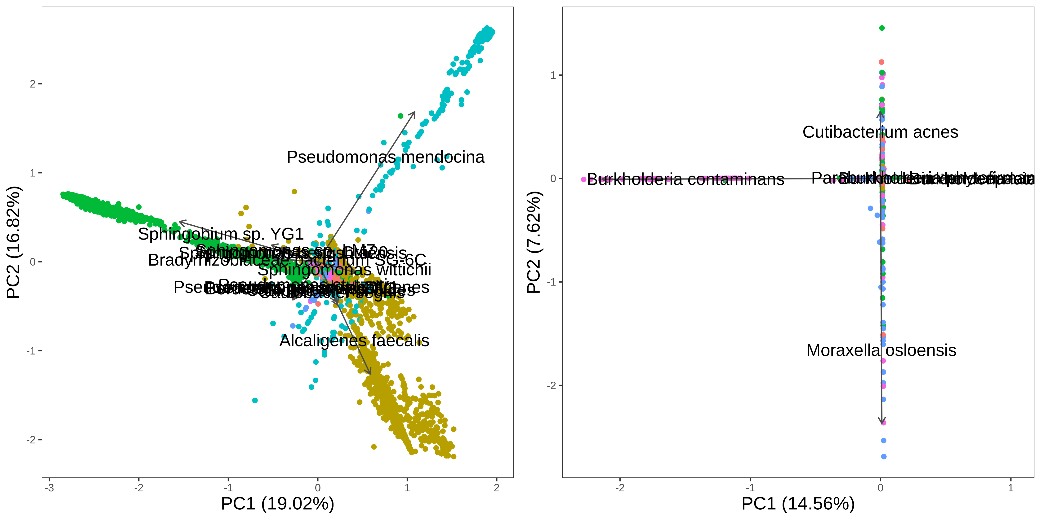
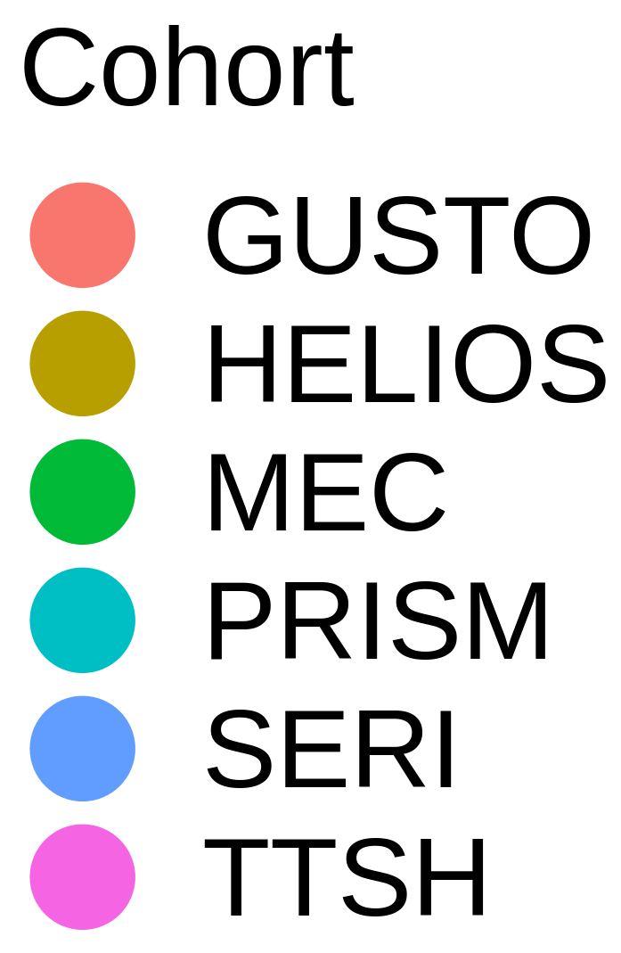
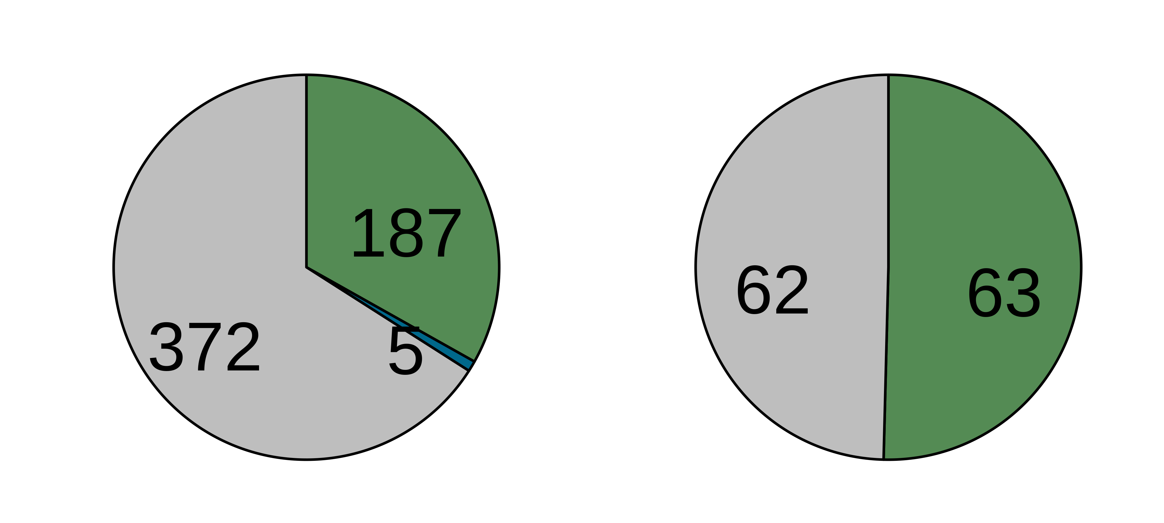
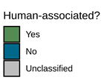
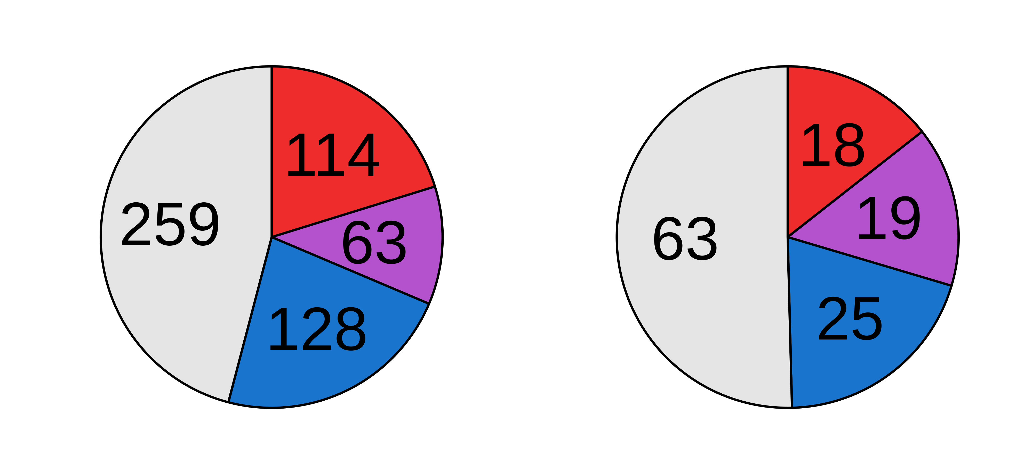
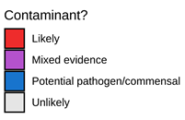
Before decontamination
After decontamination
(a)
(b)
(c)
(d)

Slide 2
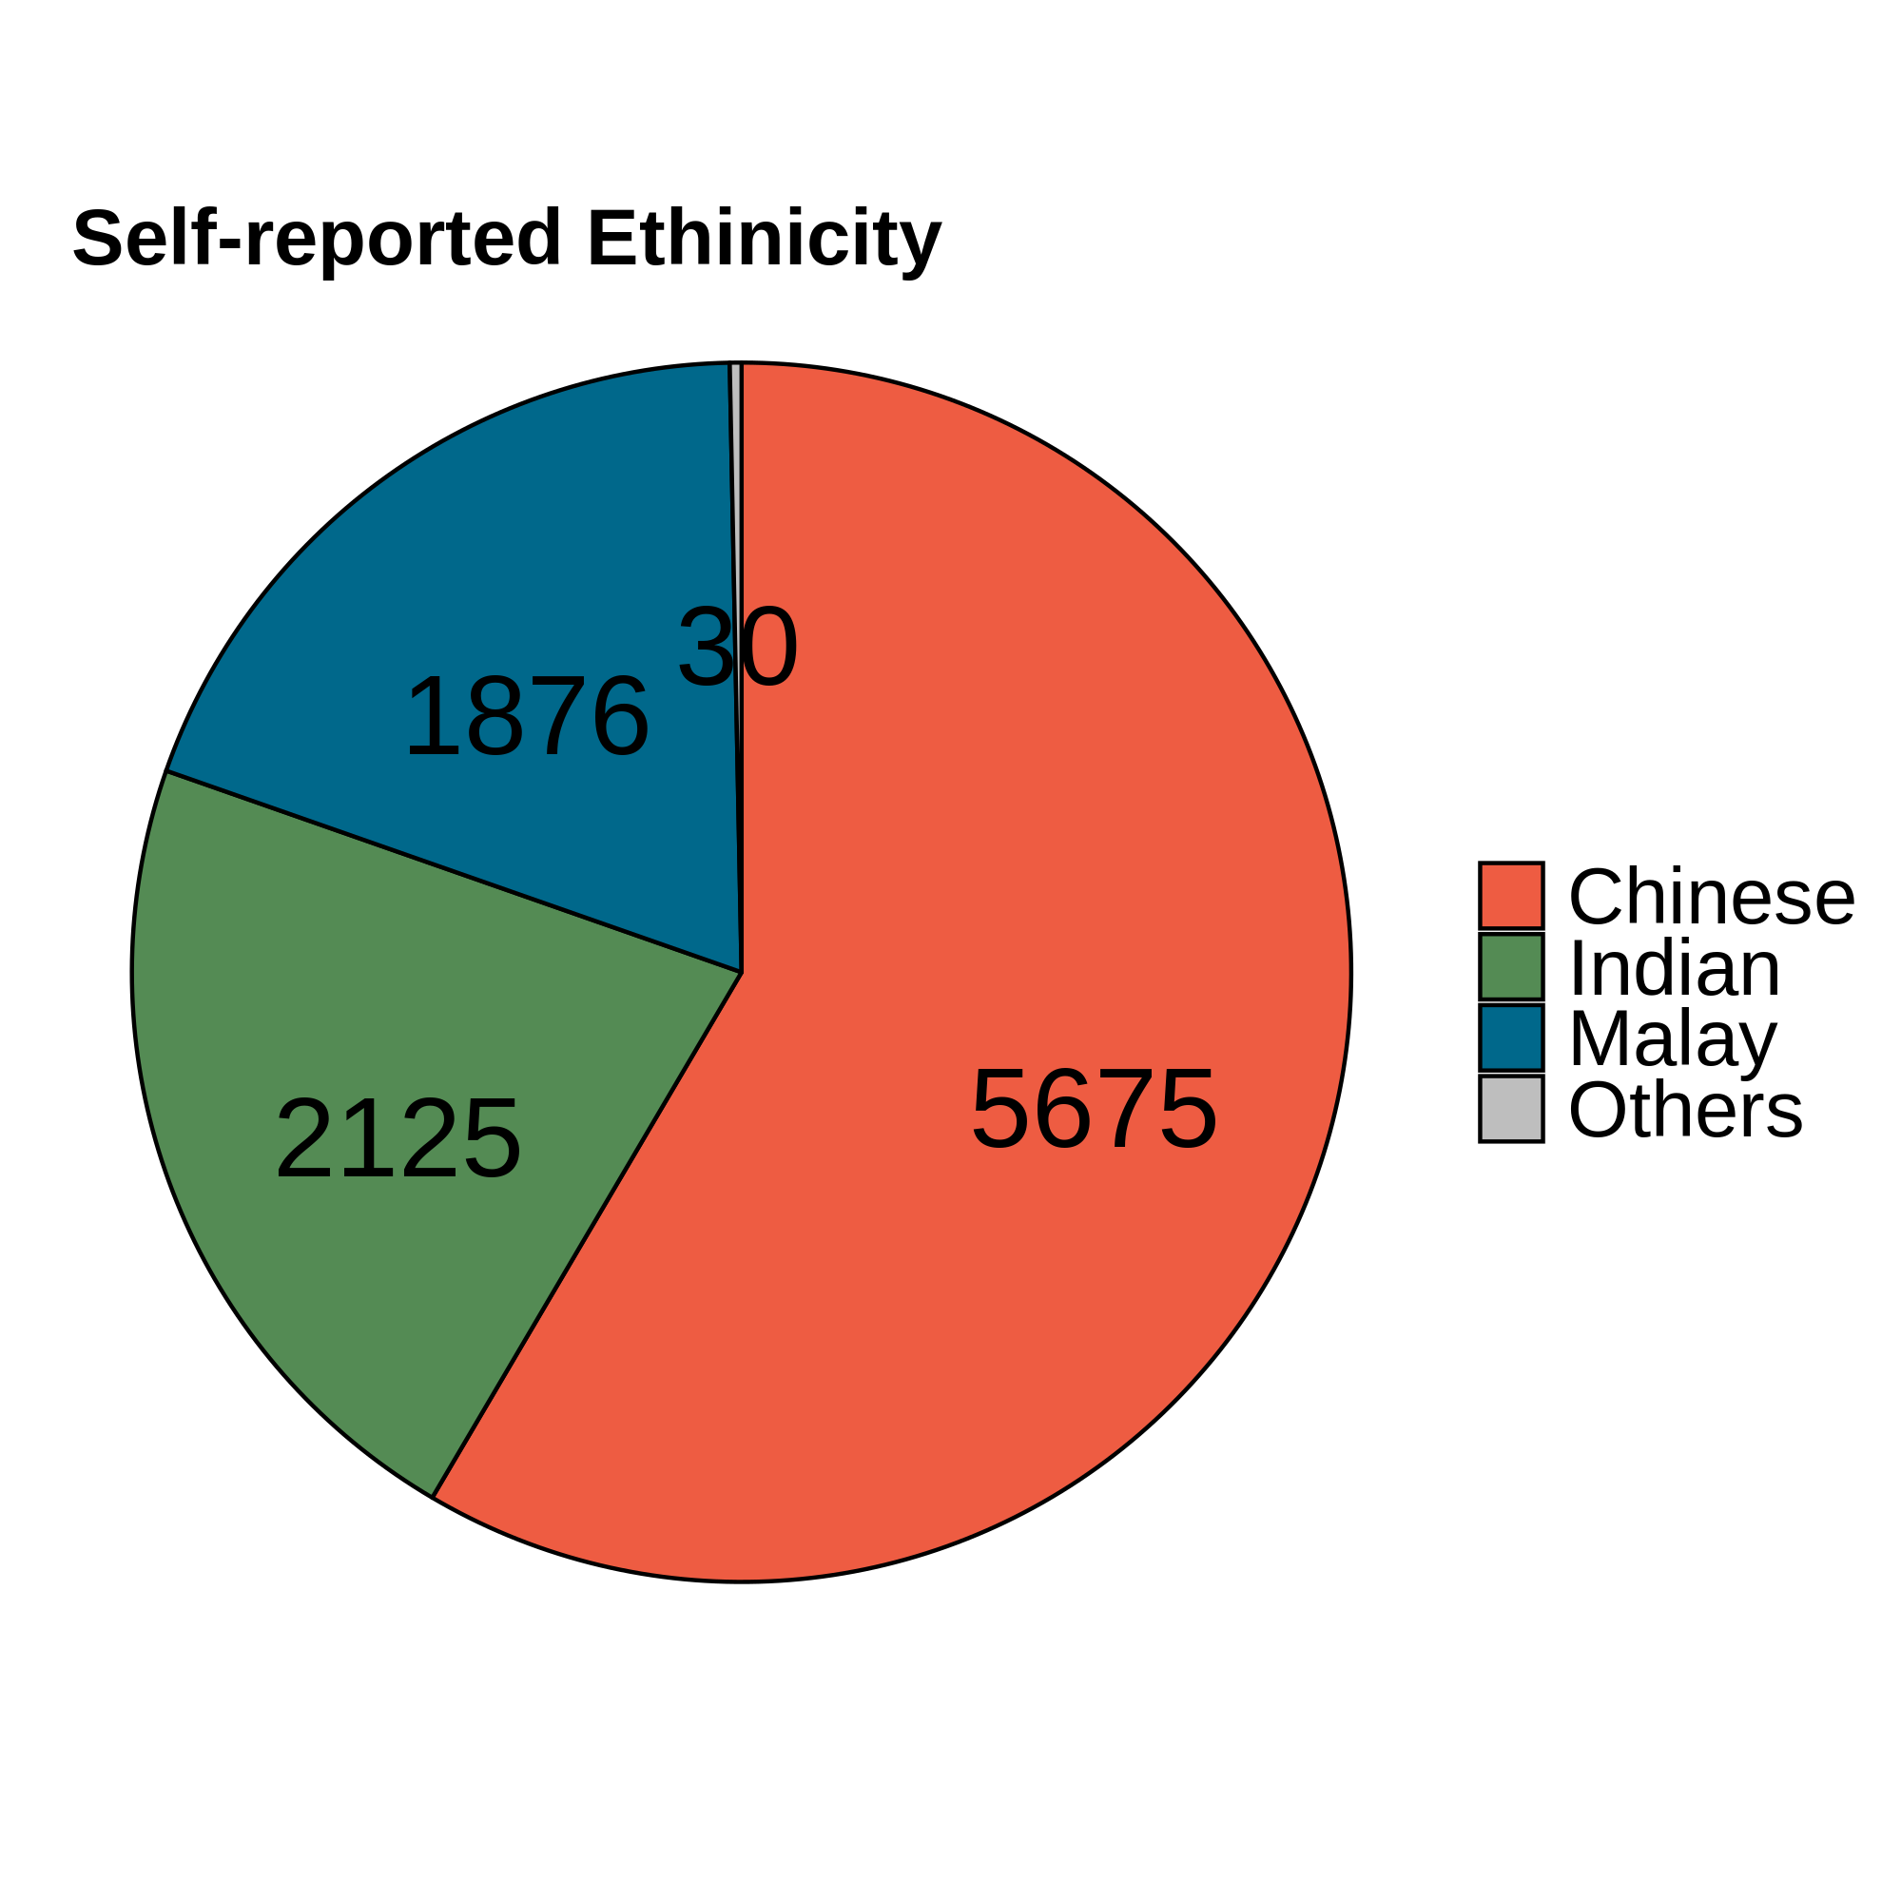
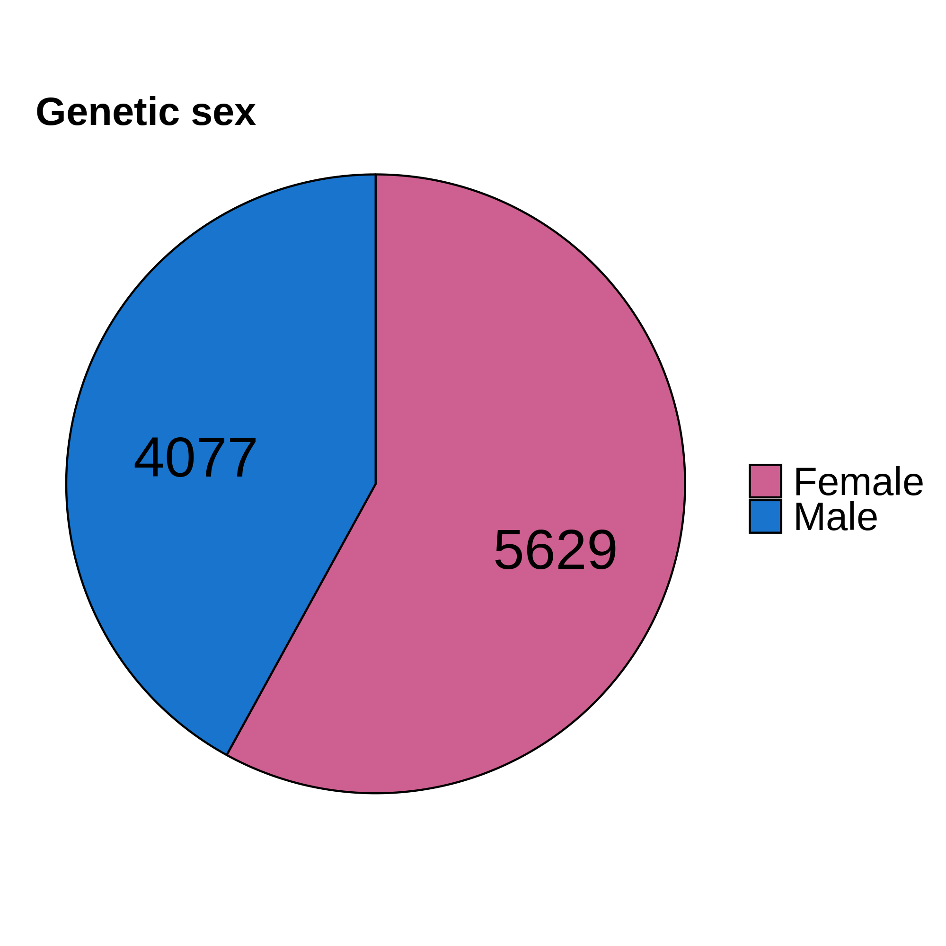
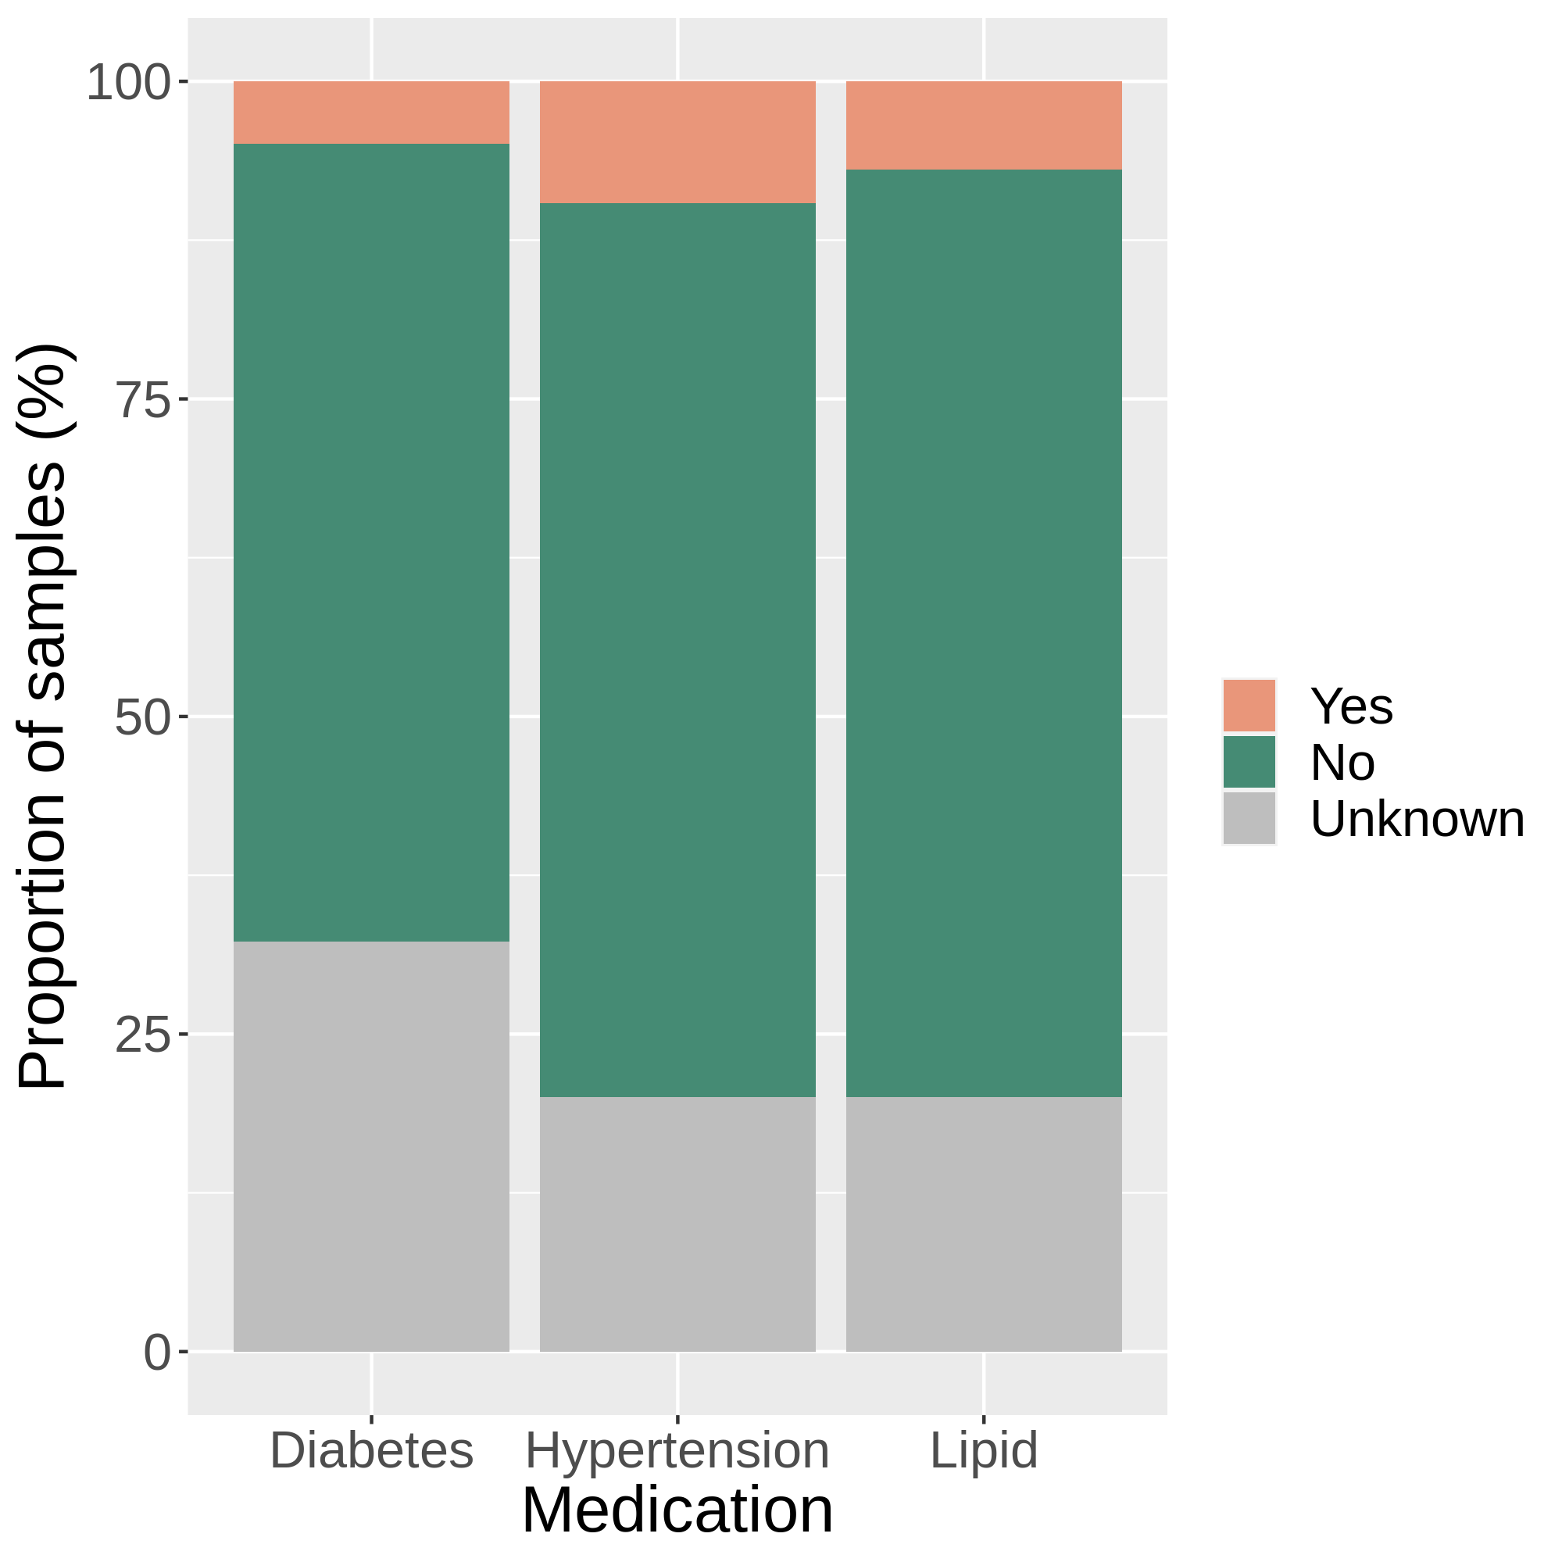
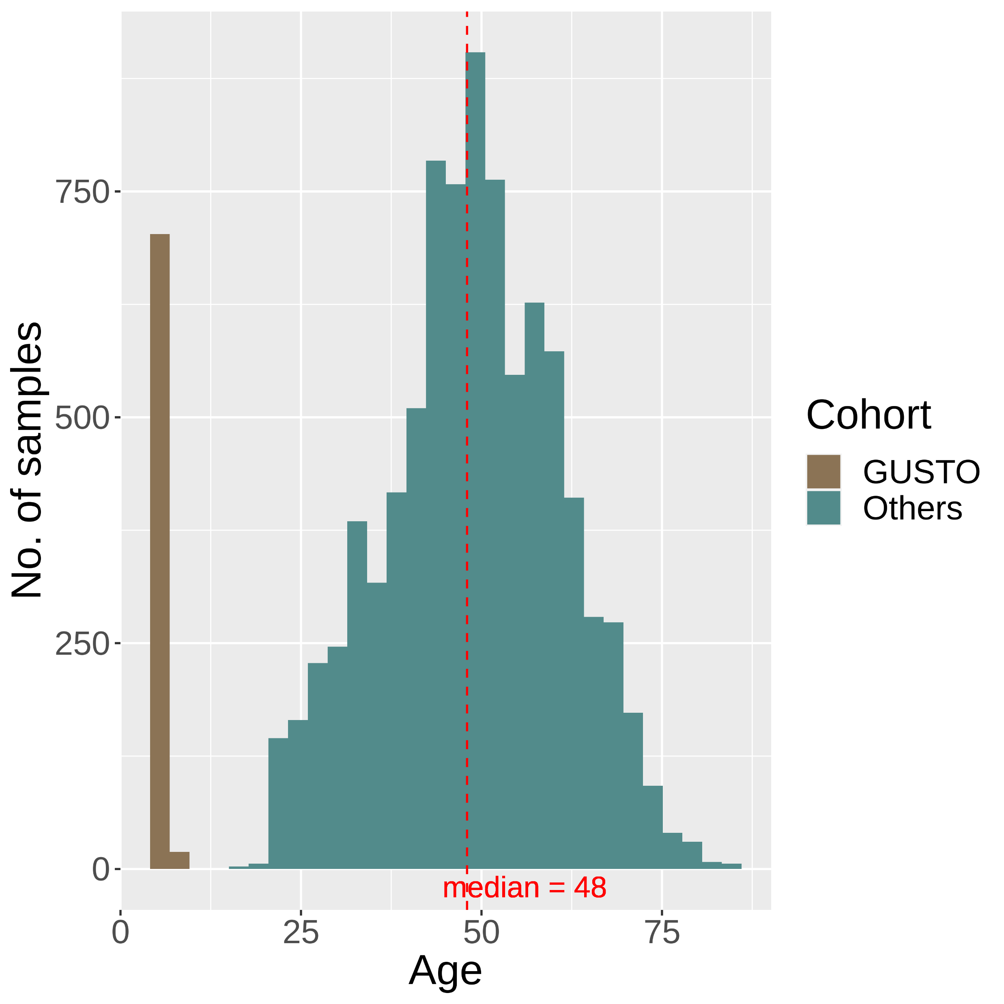
(a)
(b)
(c)
(d)

Slide 3
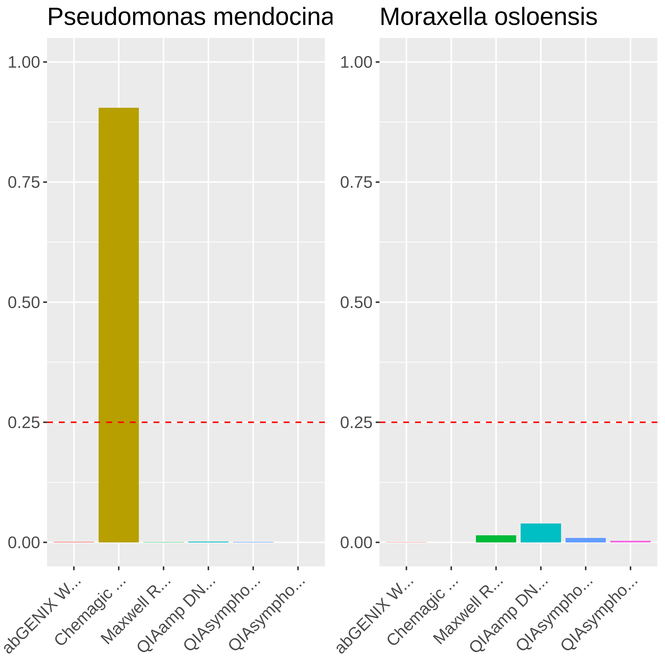
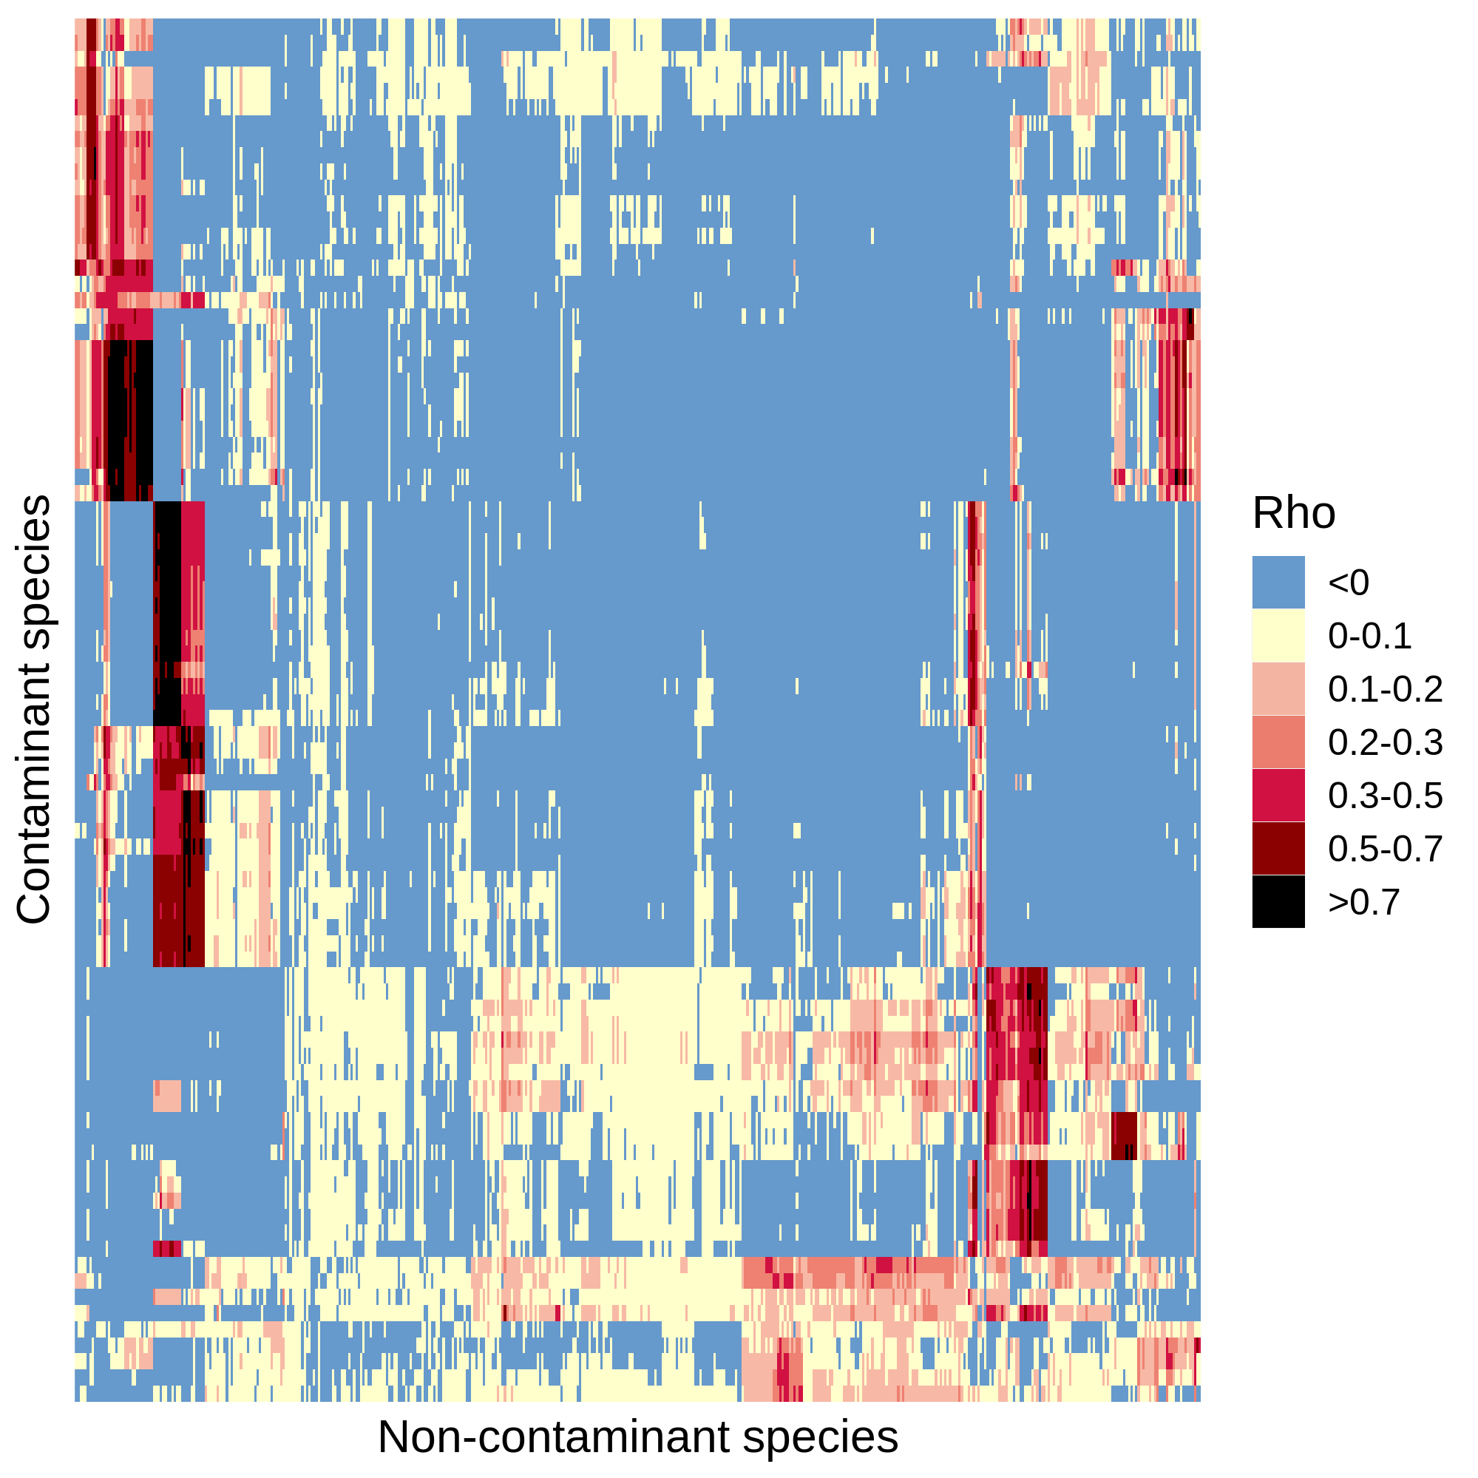
5199 species
(a)
Pre-processed Fastqs (n = 9706)
Kraken2 classification
Apply abundance thresholds
564 species
(b)
Contaminant
Non-contaminant
Filter 1
> 2-fold
Differential prevalence
478 species
(c)
Filter 2
Correlation
434 species
Filter 4
Filter 3
Downstream analyses
Max read count filter
Batch filter
176 species
125 species

Slide 4
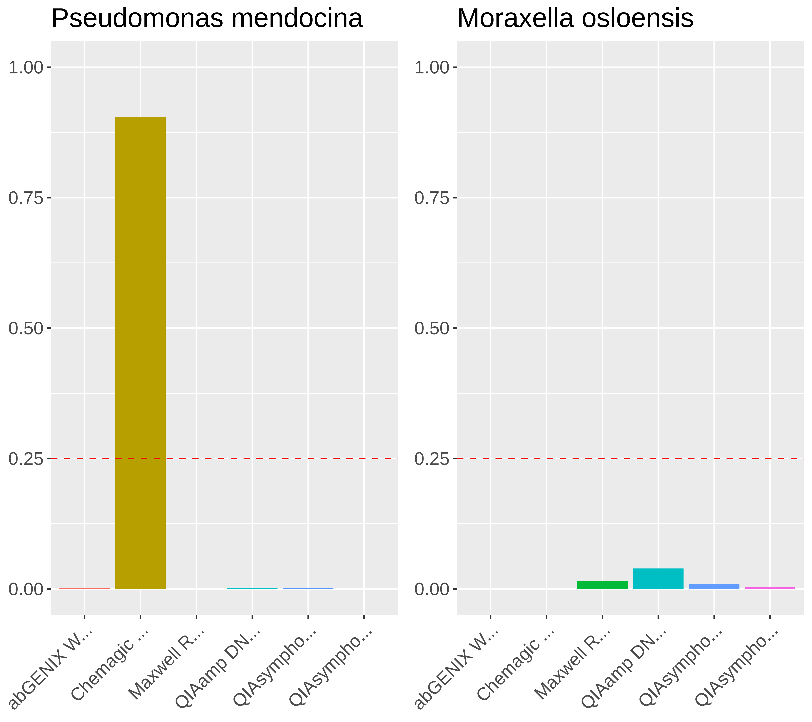
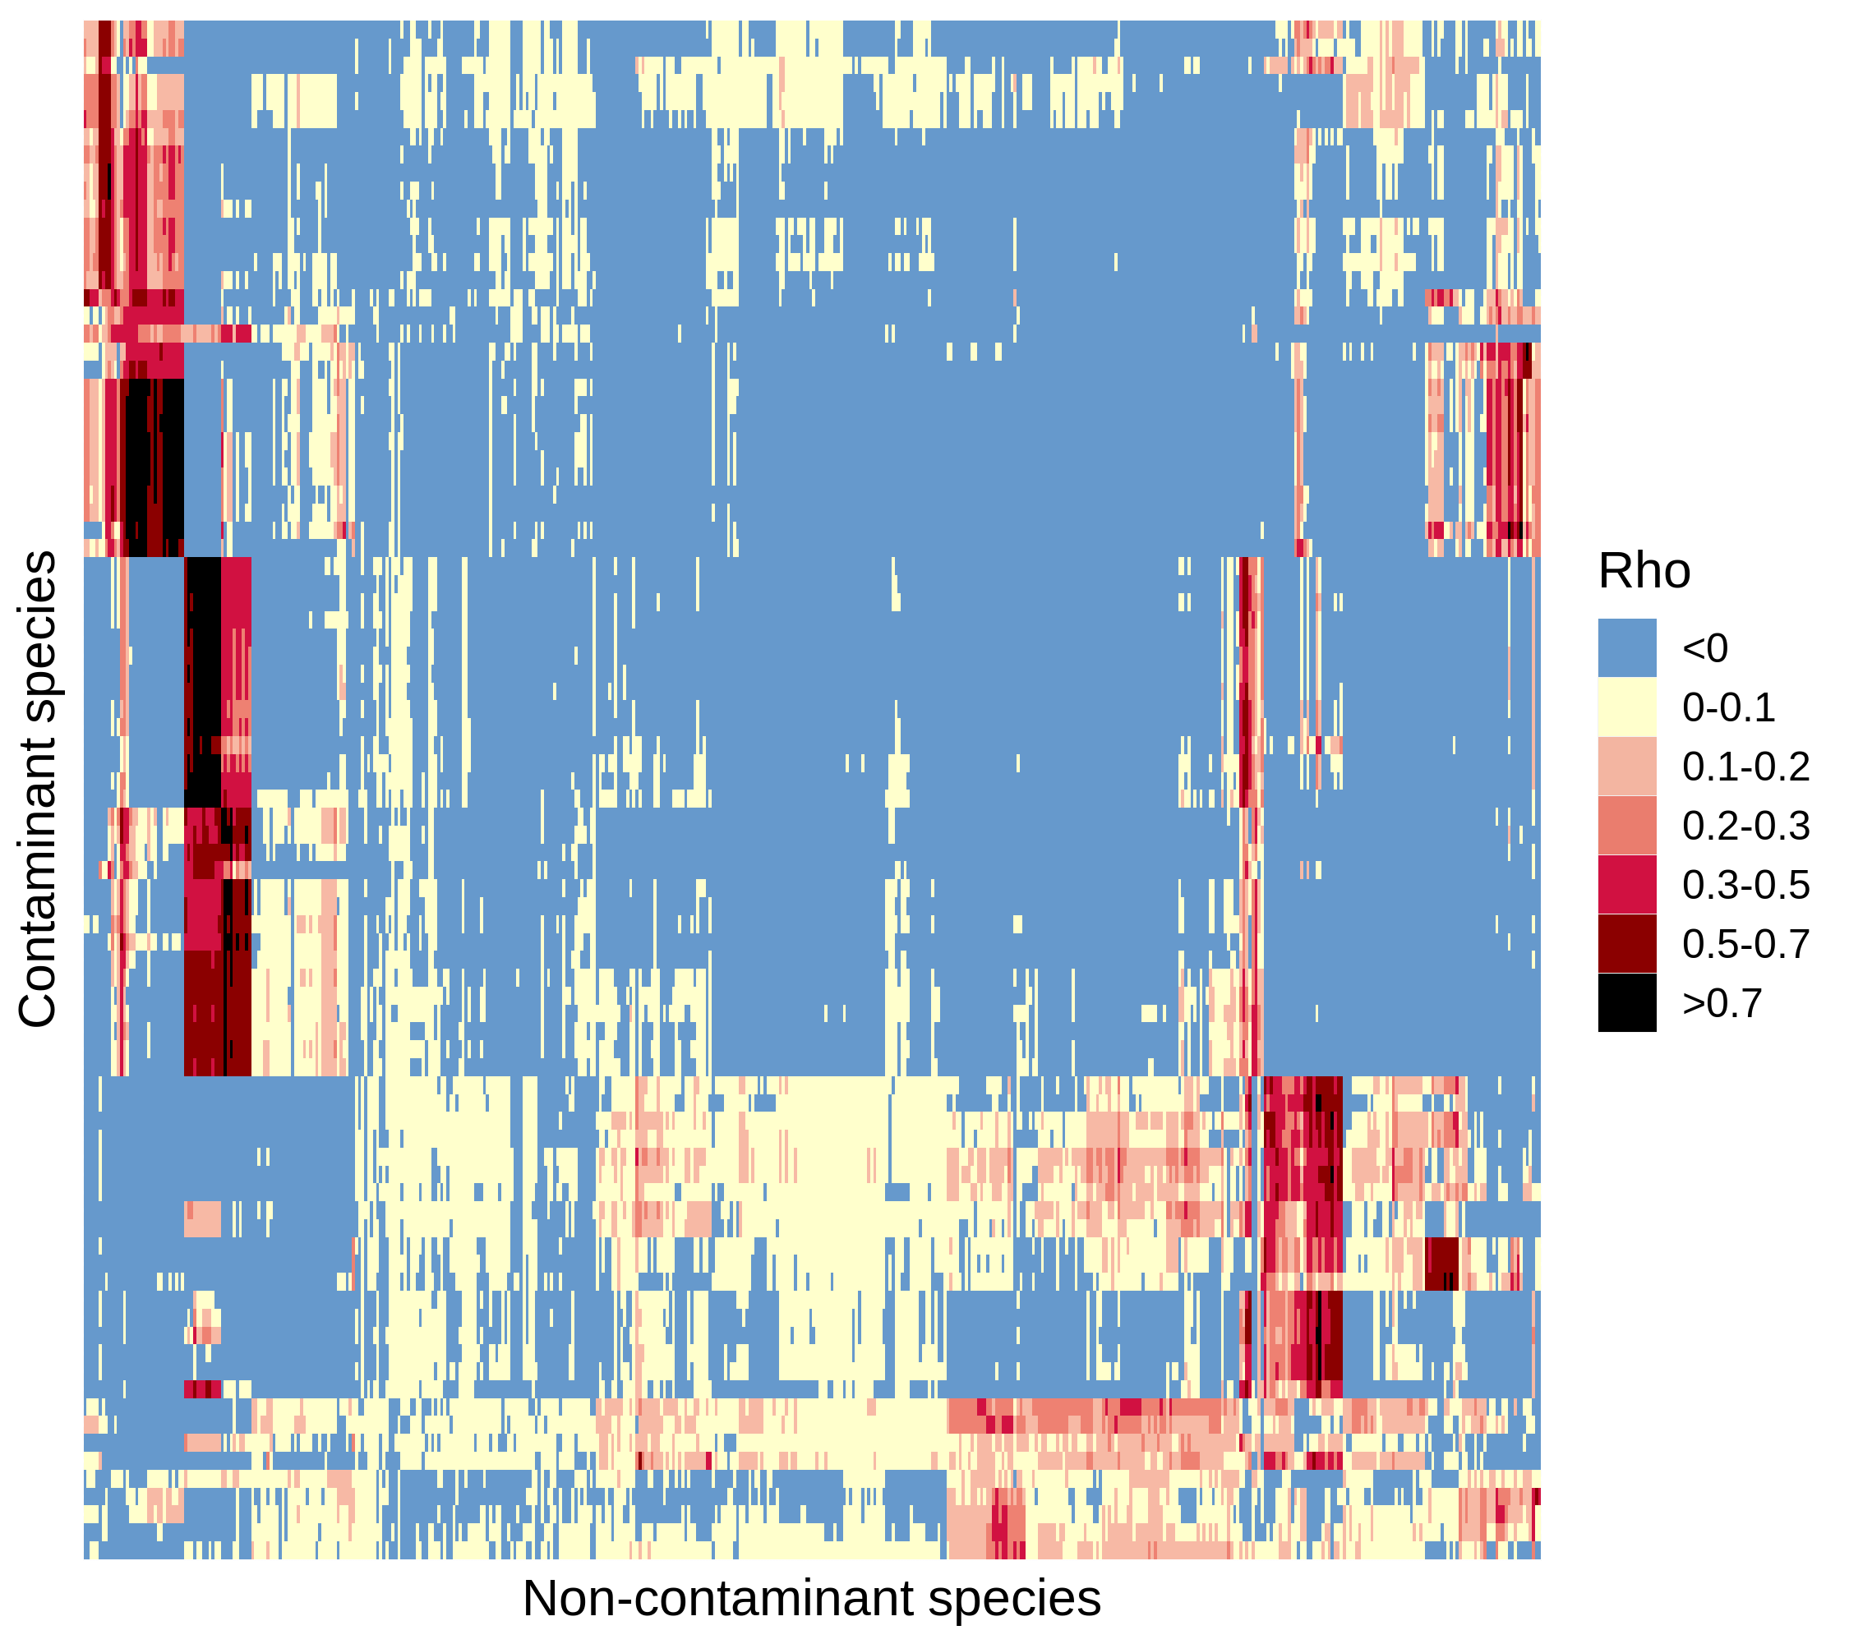
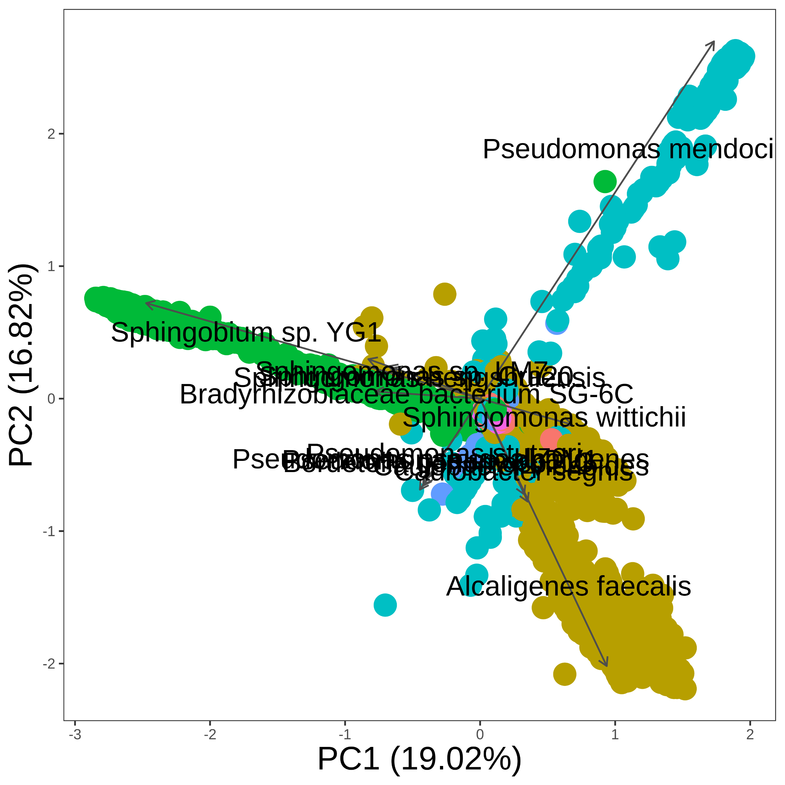
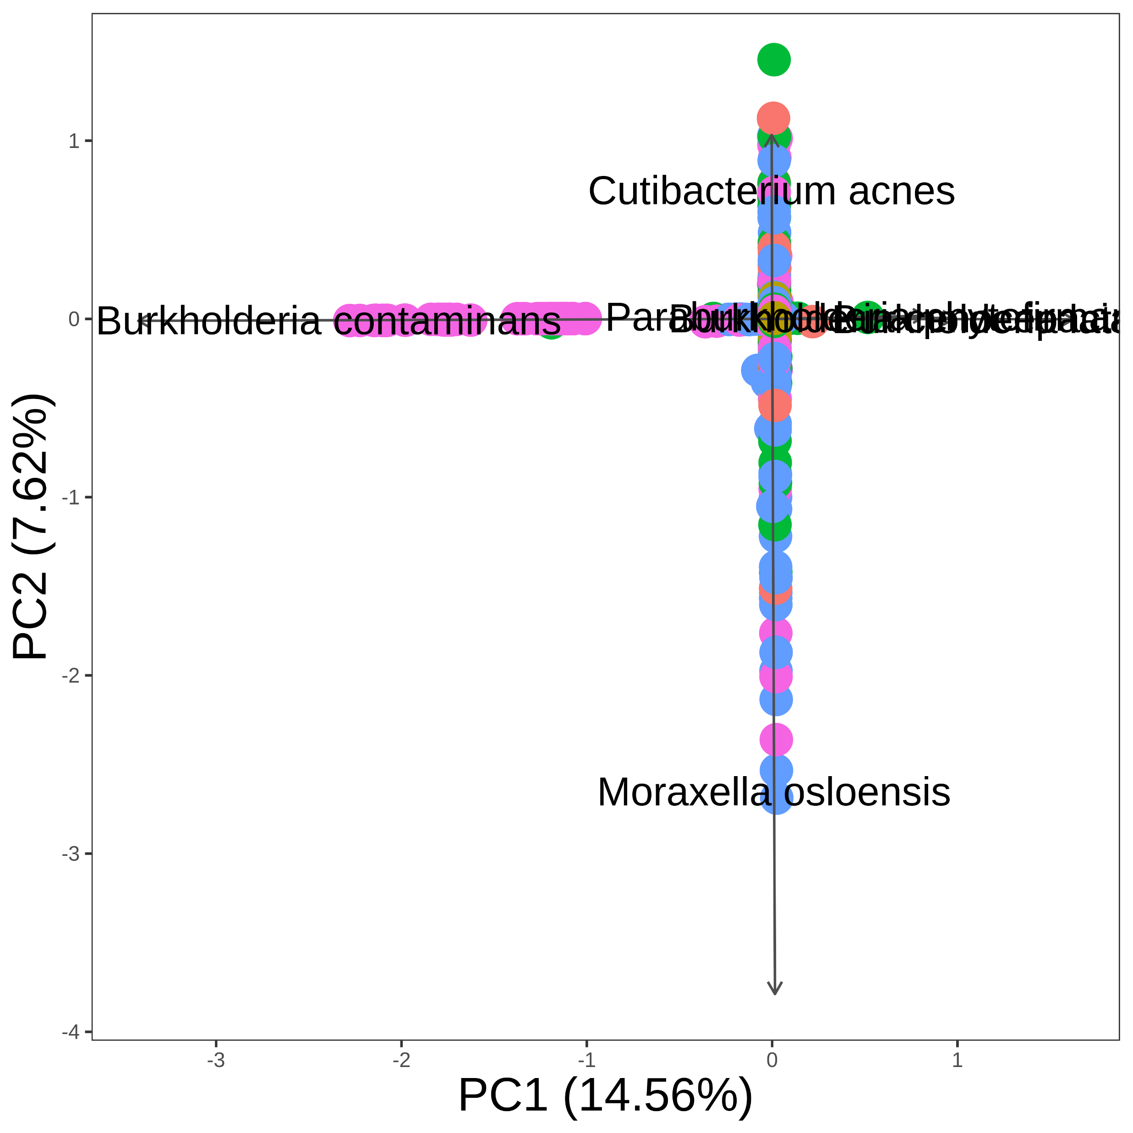
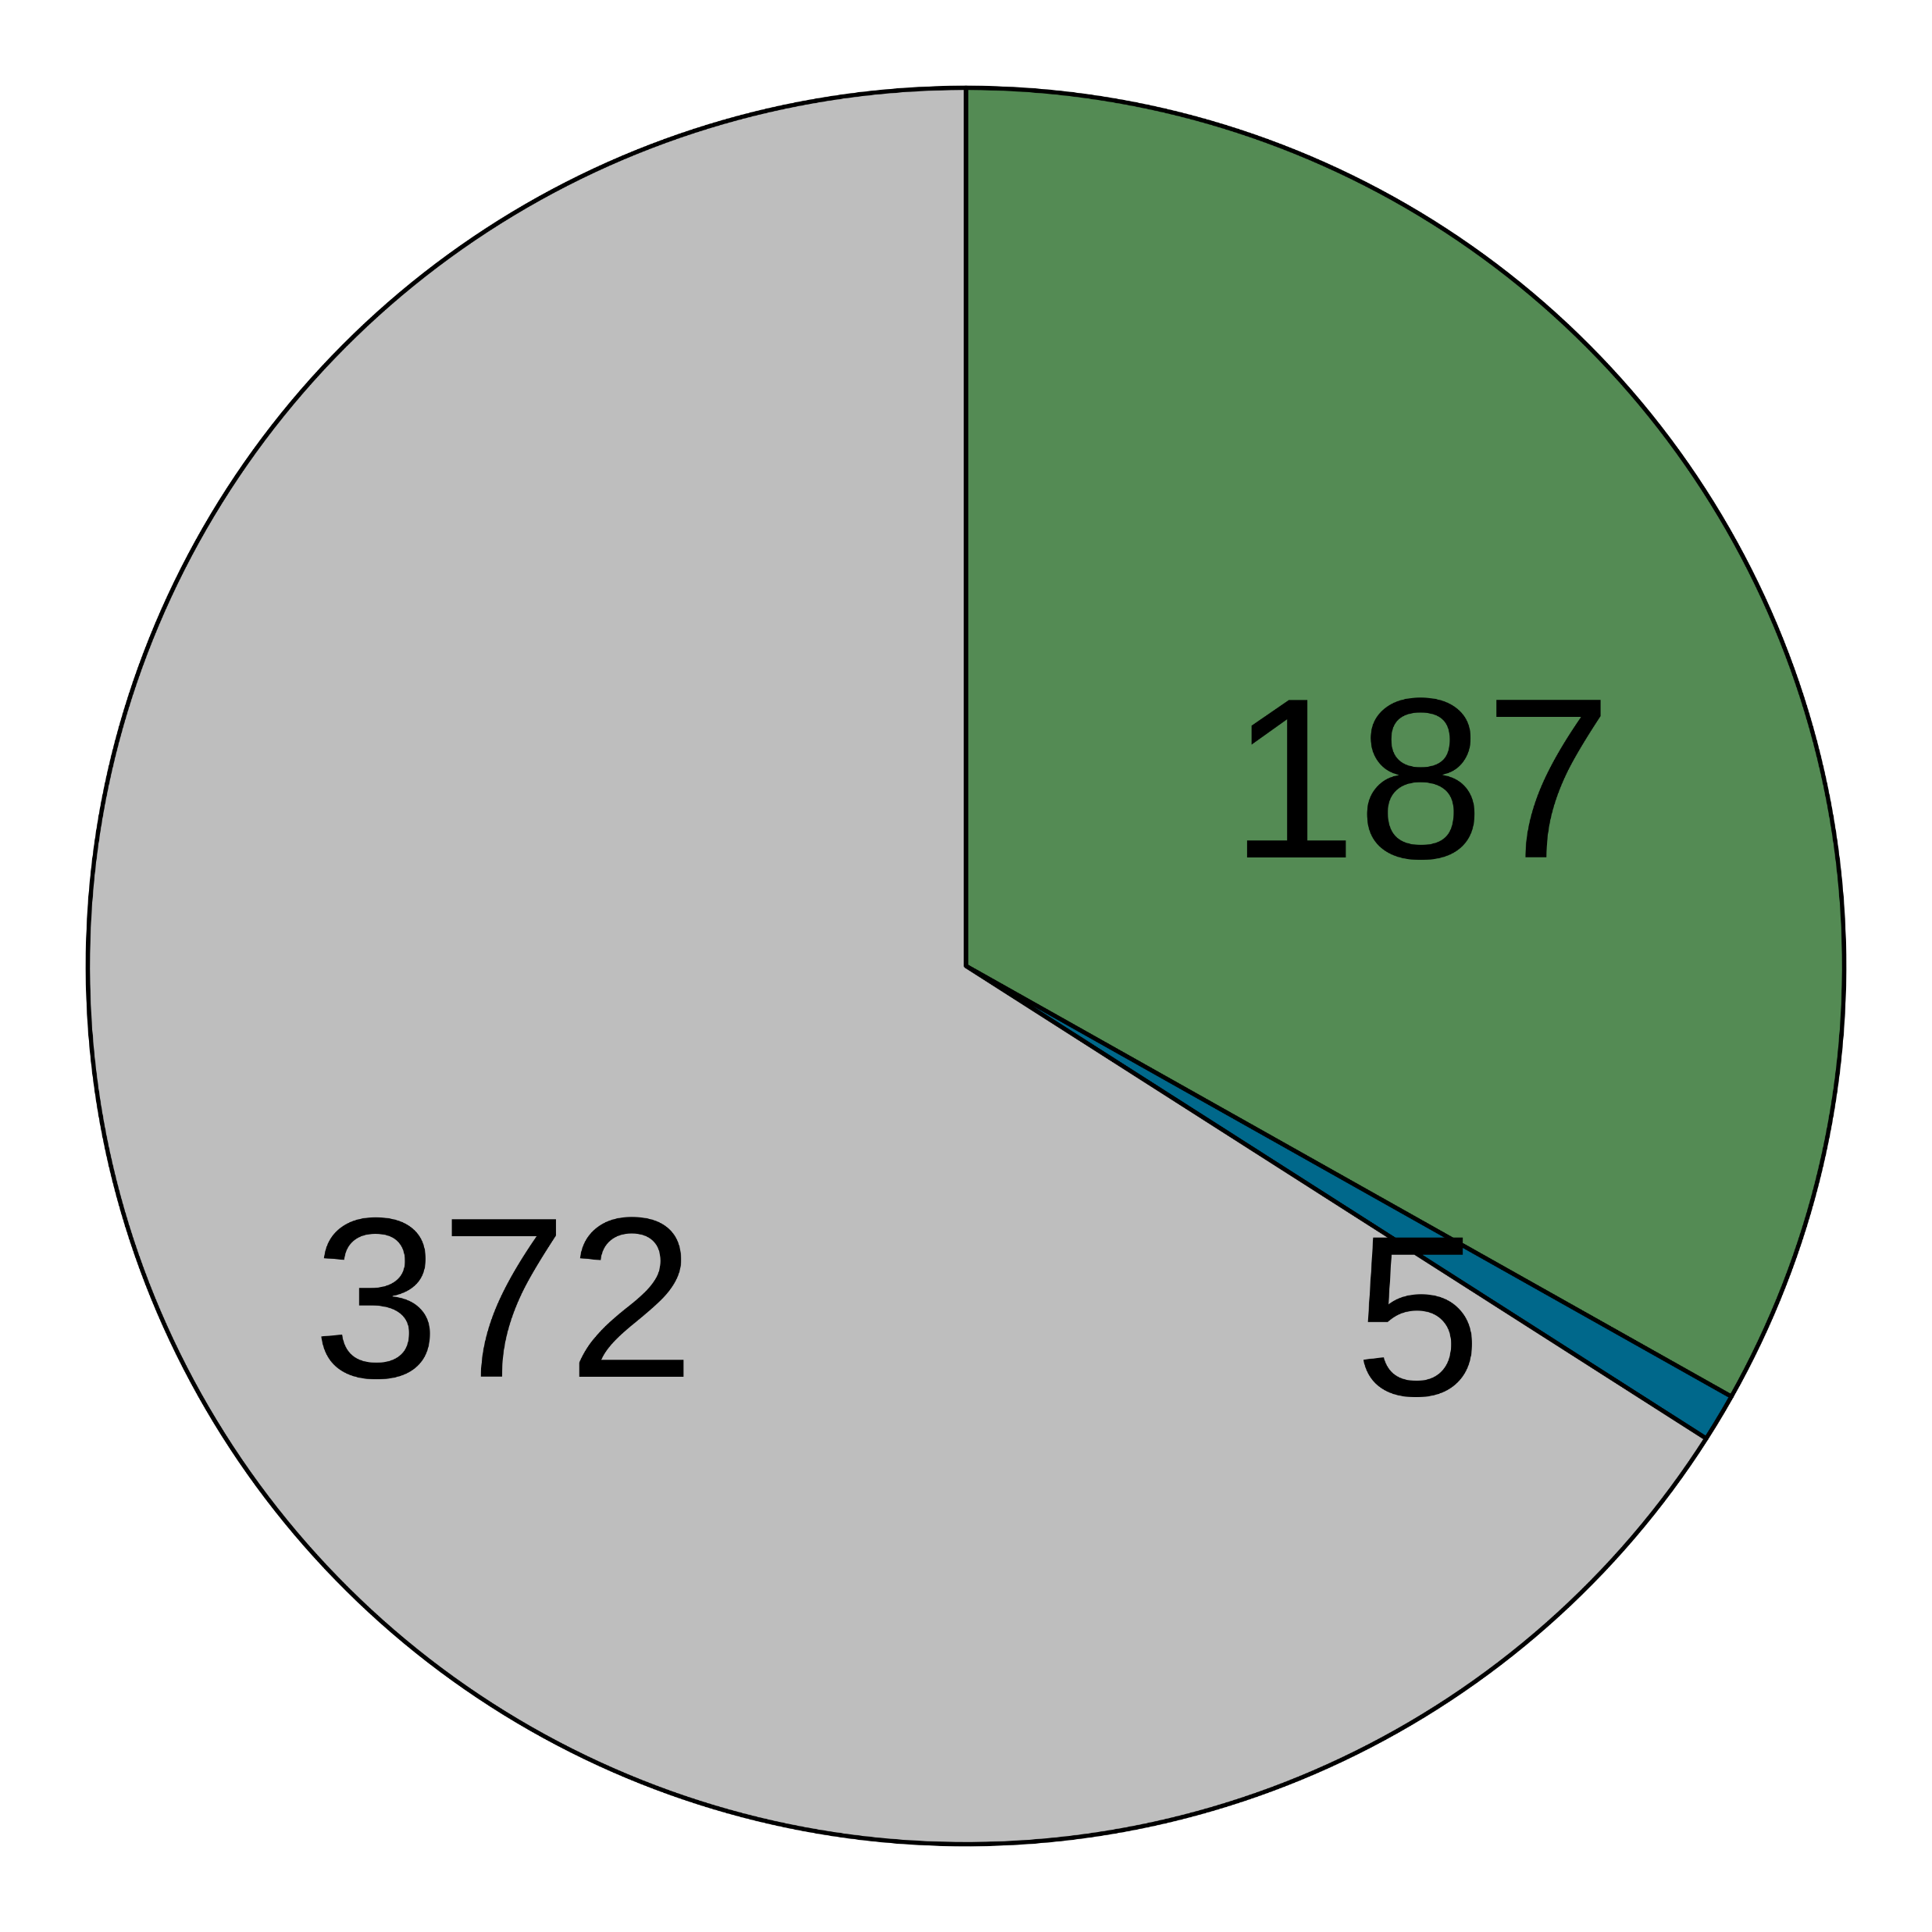
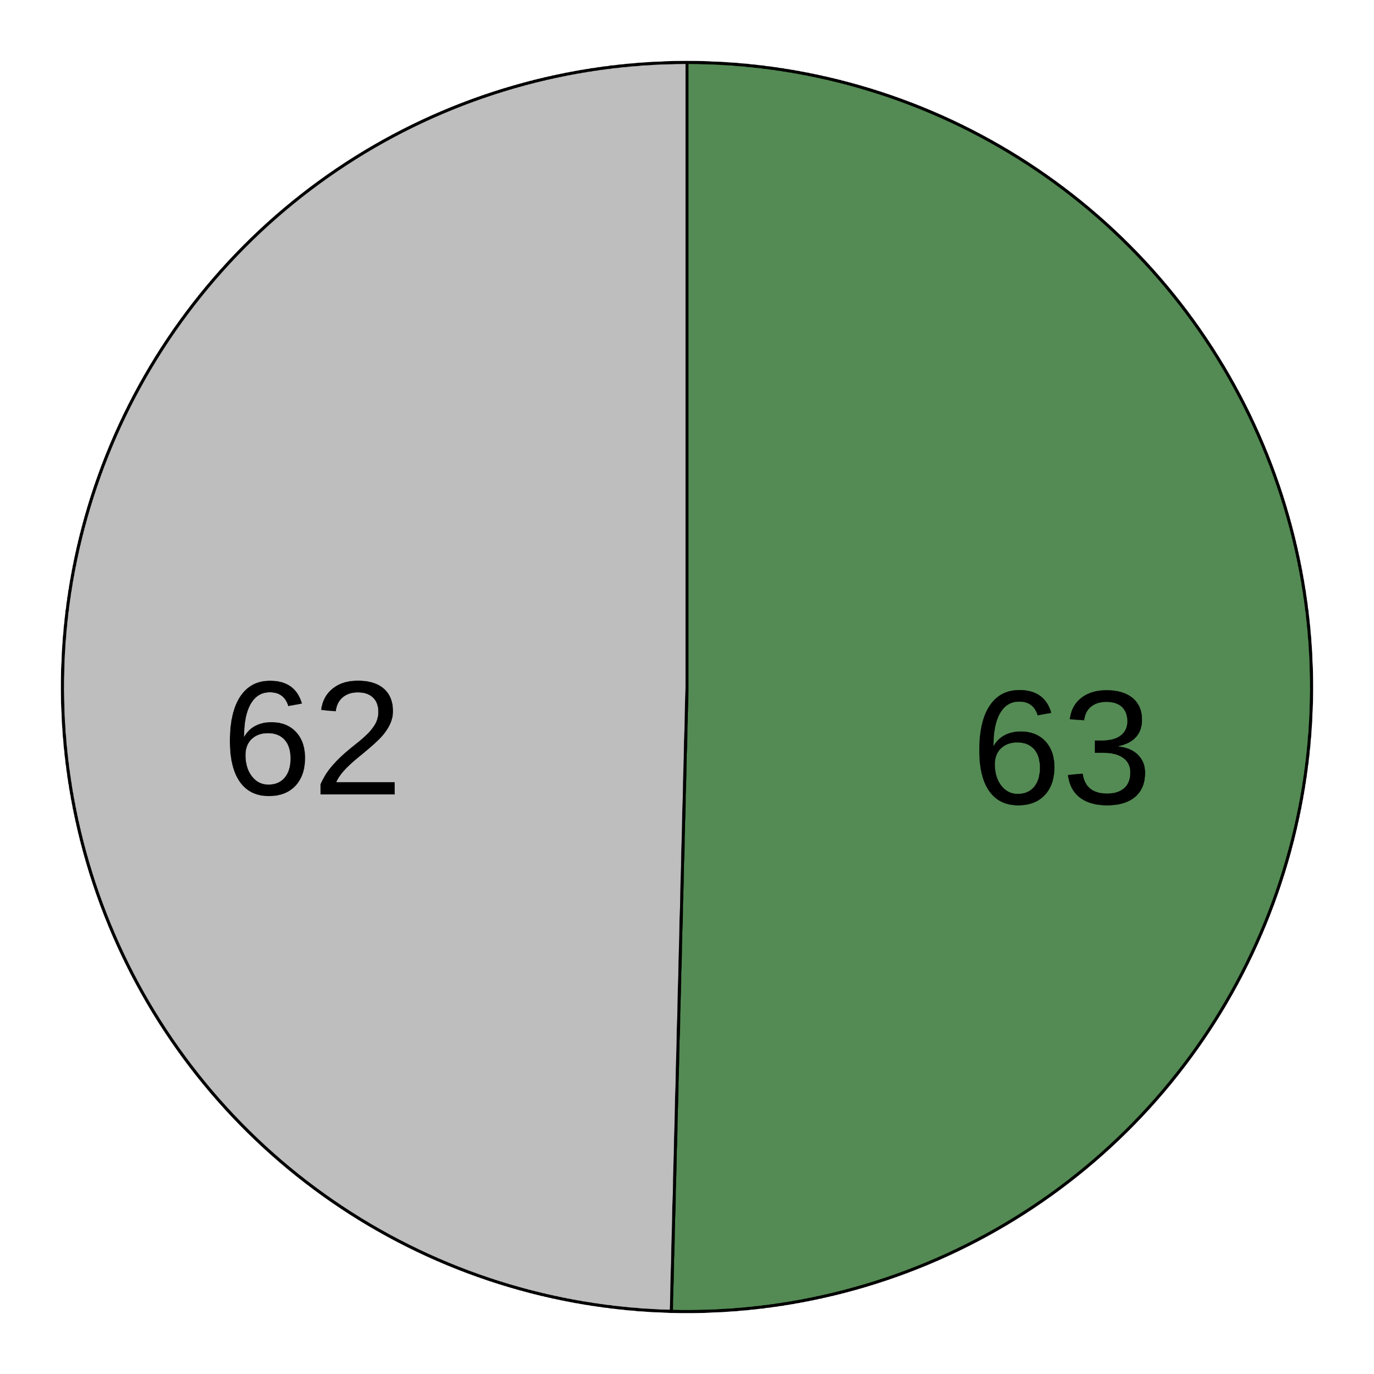
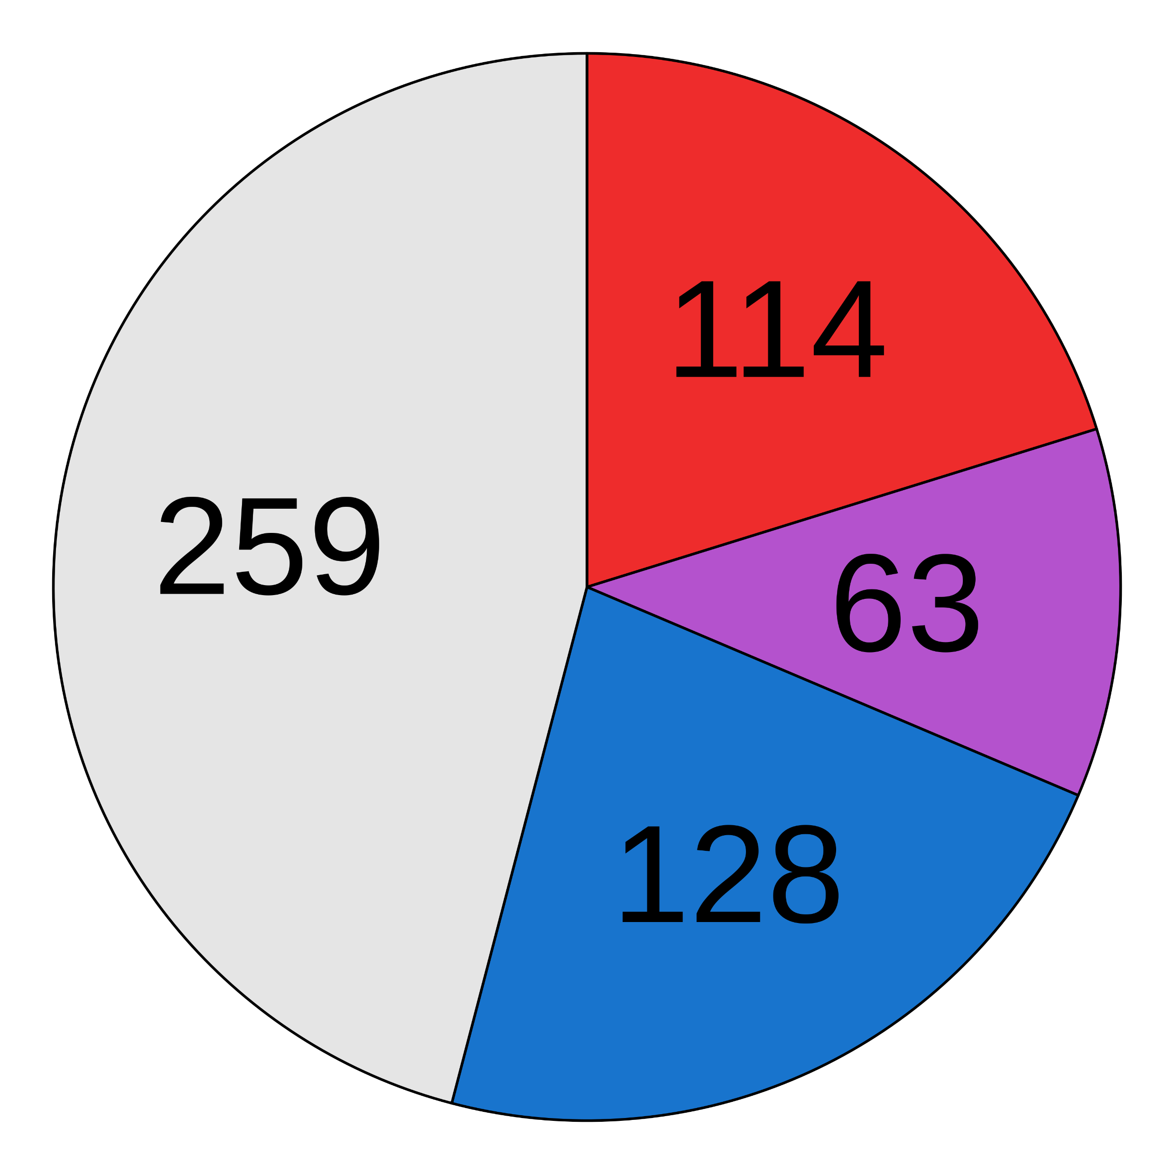
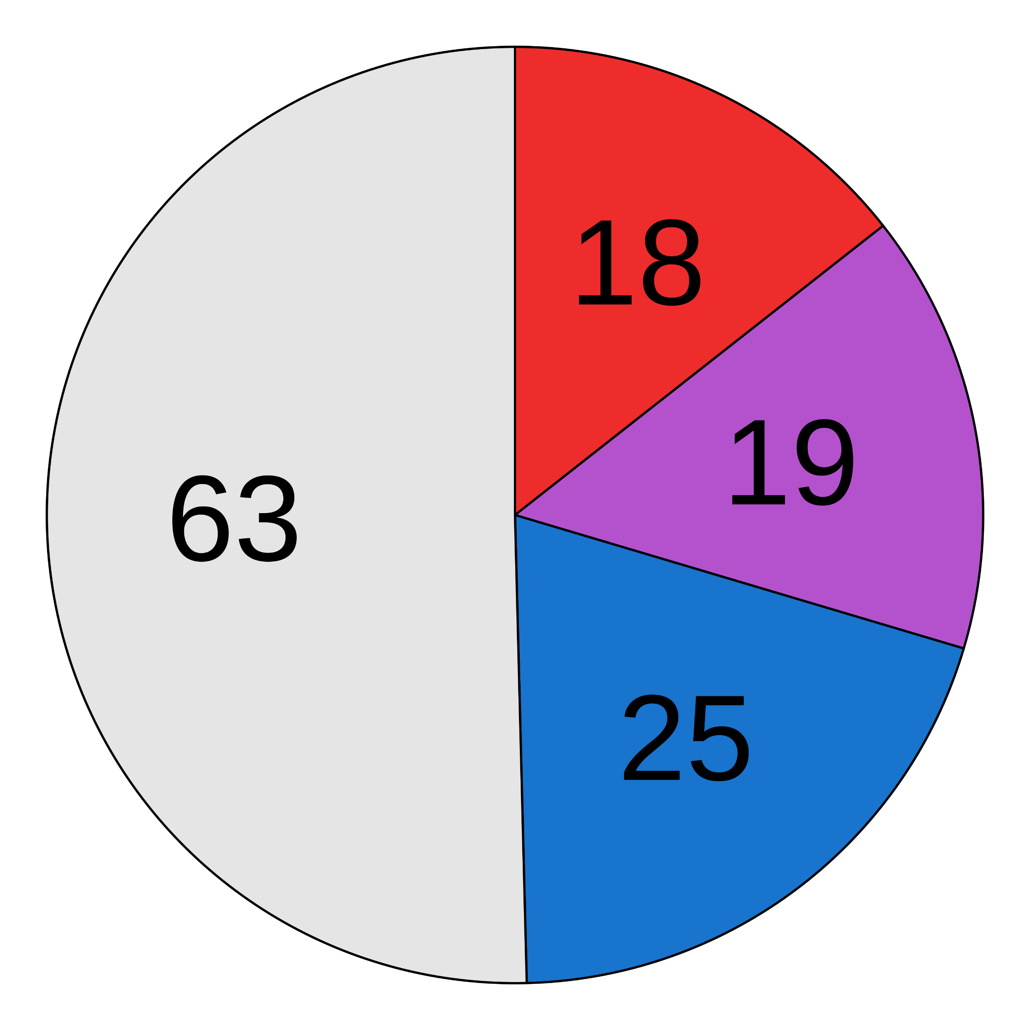
(a)
Pre-processed fastqs (n = 9706)
Kraken2 classification
Apply abundance thresholds
5199 species
564 species
Filter 1
Filter 2
Filter 3
Filter 4
Differential prevalence
Correlation
Batch filter
Max read count filter
Downstream analyses
478 species
434 species
176 species
125 species
(b)
Contaminant
Non-contaminant
(c)
> 2-fold
Before decontamination
After decontamination
(d)
(e)
(f)
(g)

Slide 5
(a)
Pre-processed fastqs (n = 9706)
Kraken2 classification
Apply abundance thresholds
5199 species
564 species
Filter 1
Filter 2
Filter 3
Filter 4
Differential prevalence
Correlation
Batch filter
Max read count filter
Downstream analyses
478 species
434 species
176 species
125 species
Before decontamination
After decontamination
(b)
(c)
(d)
(e)

Slide 6
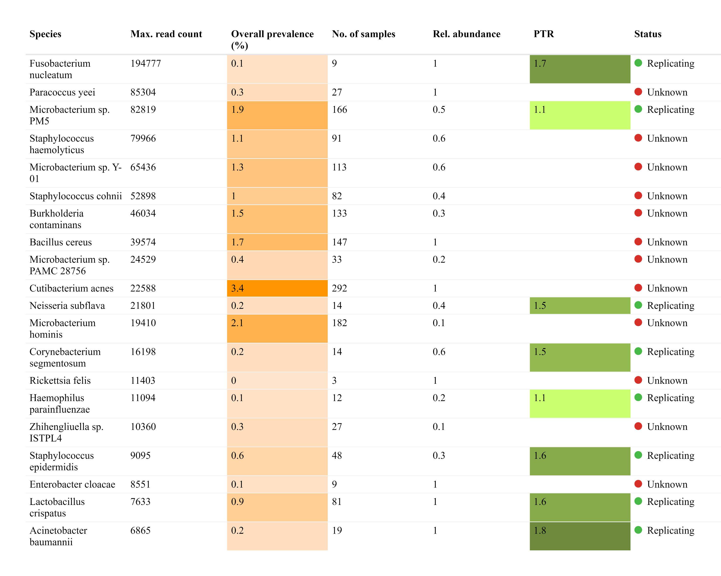
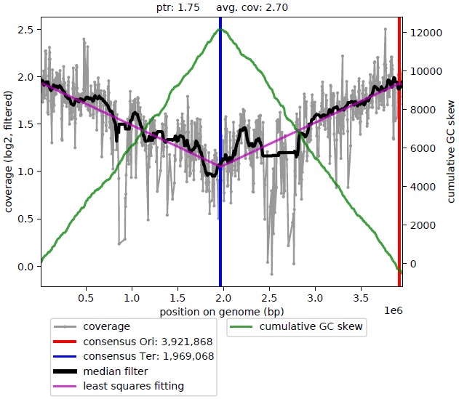
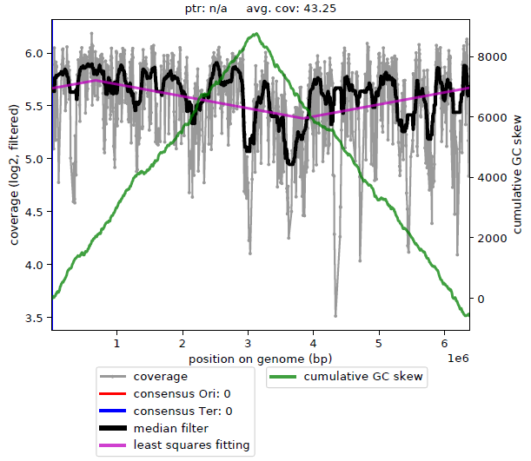
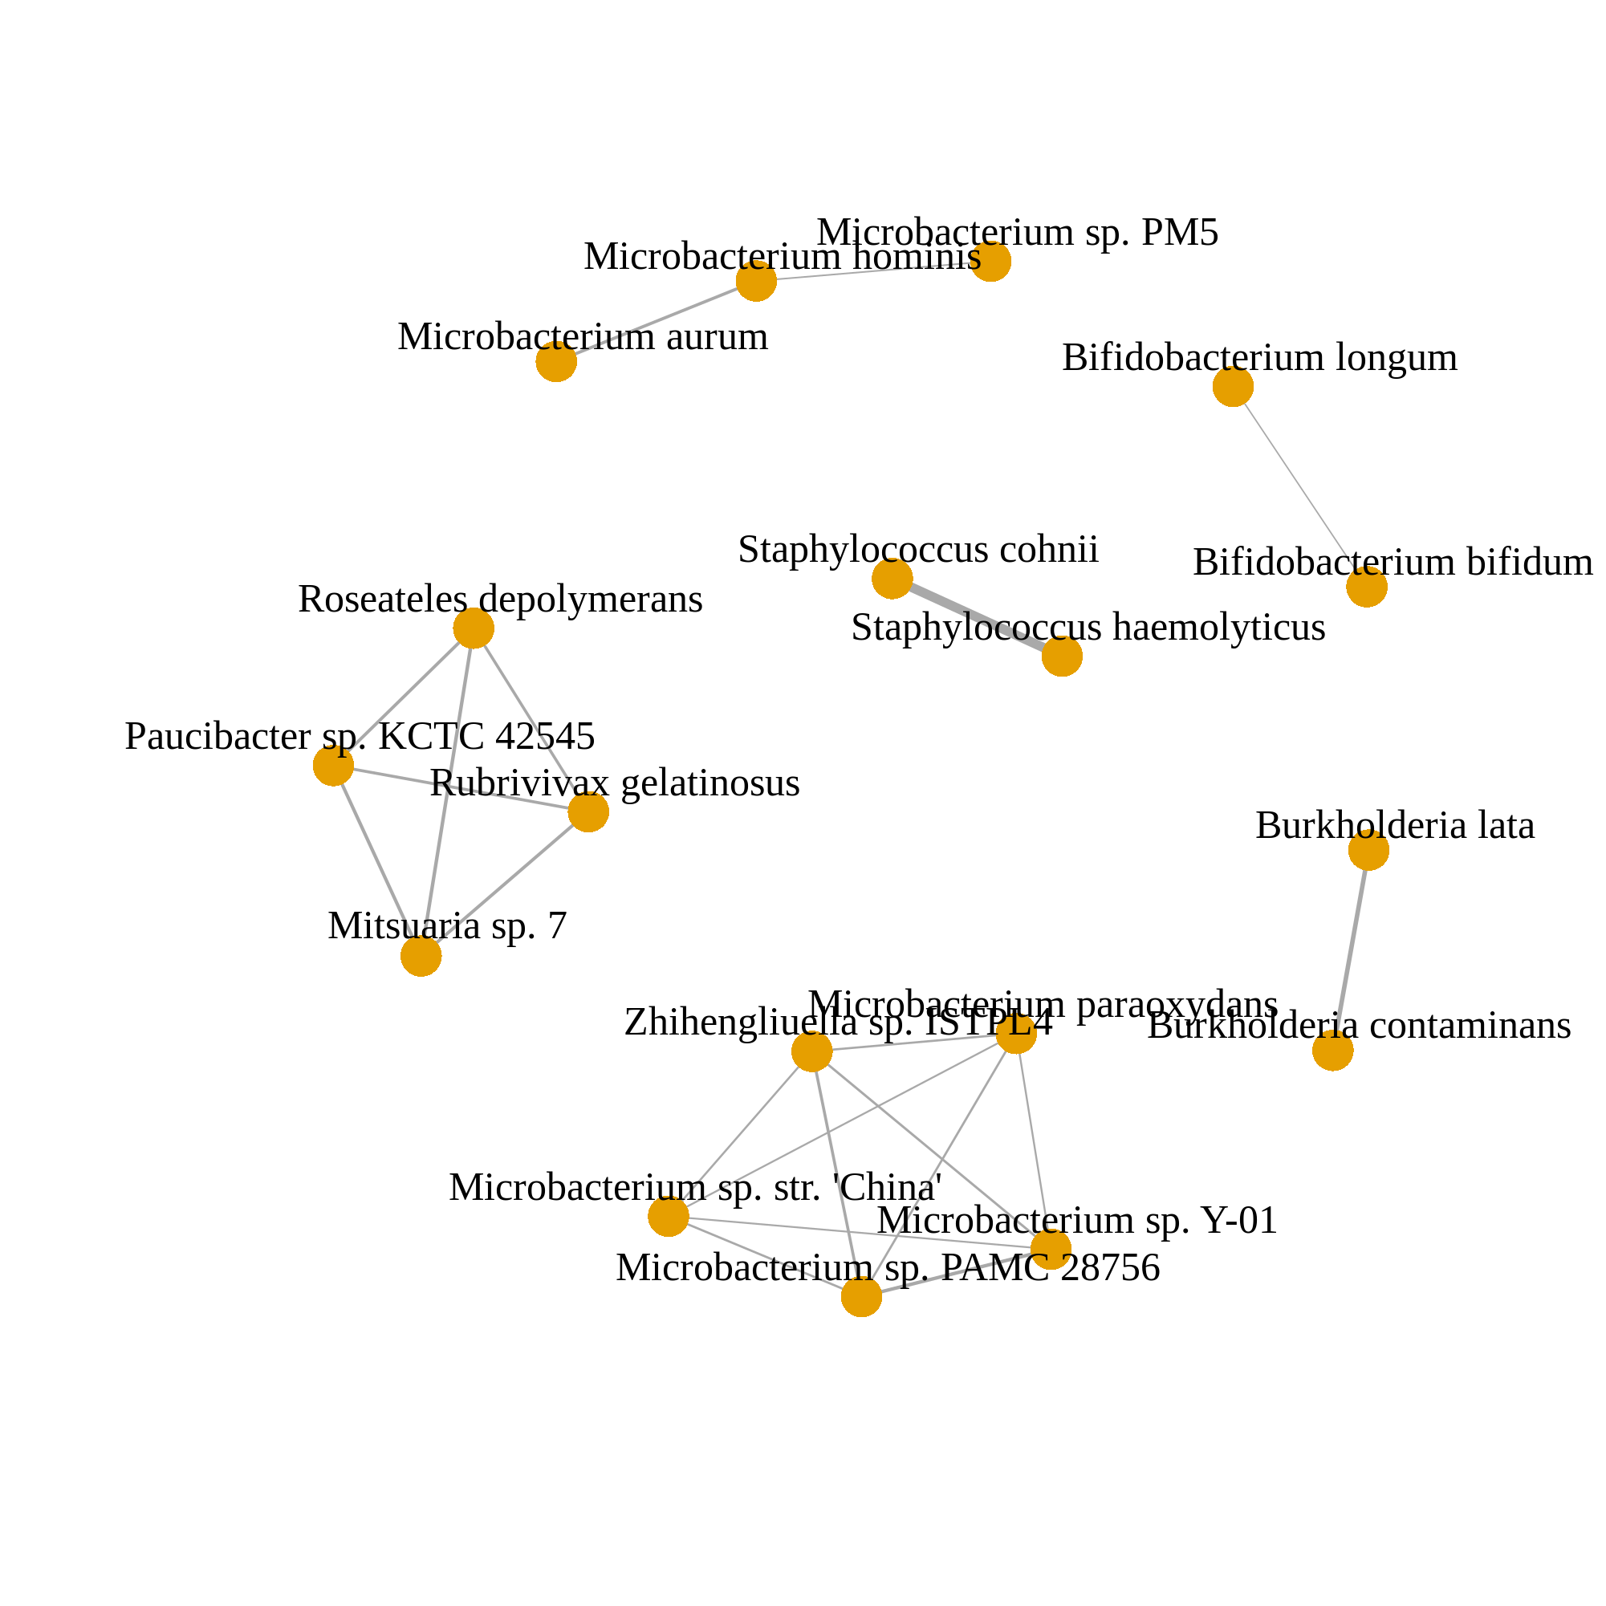
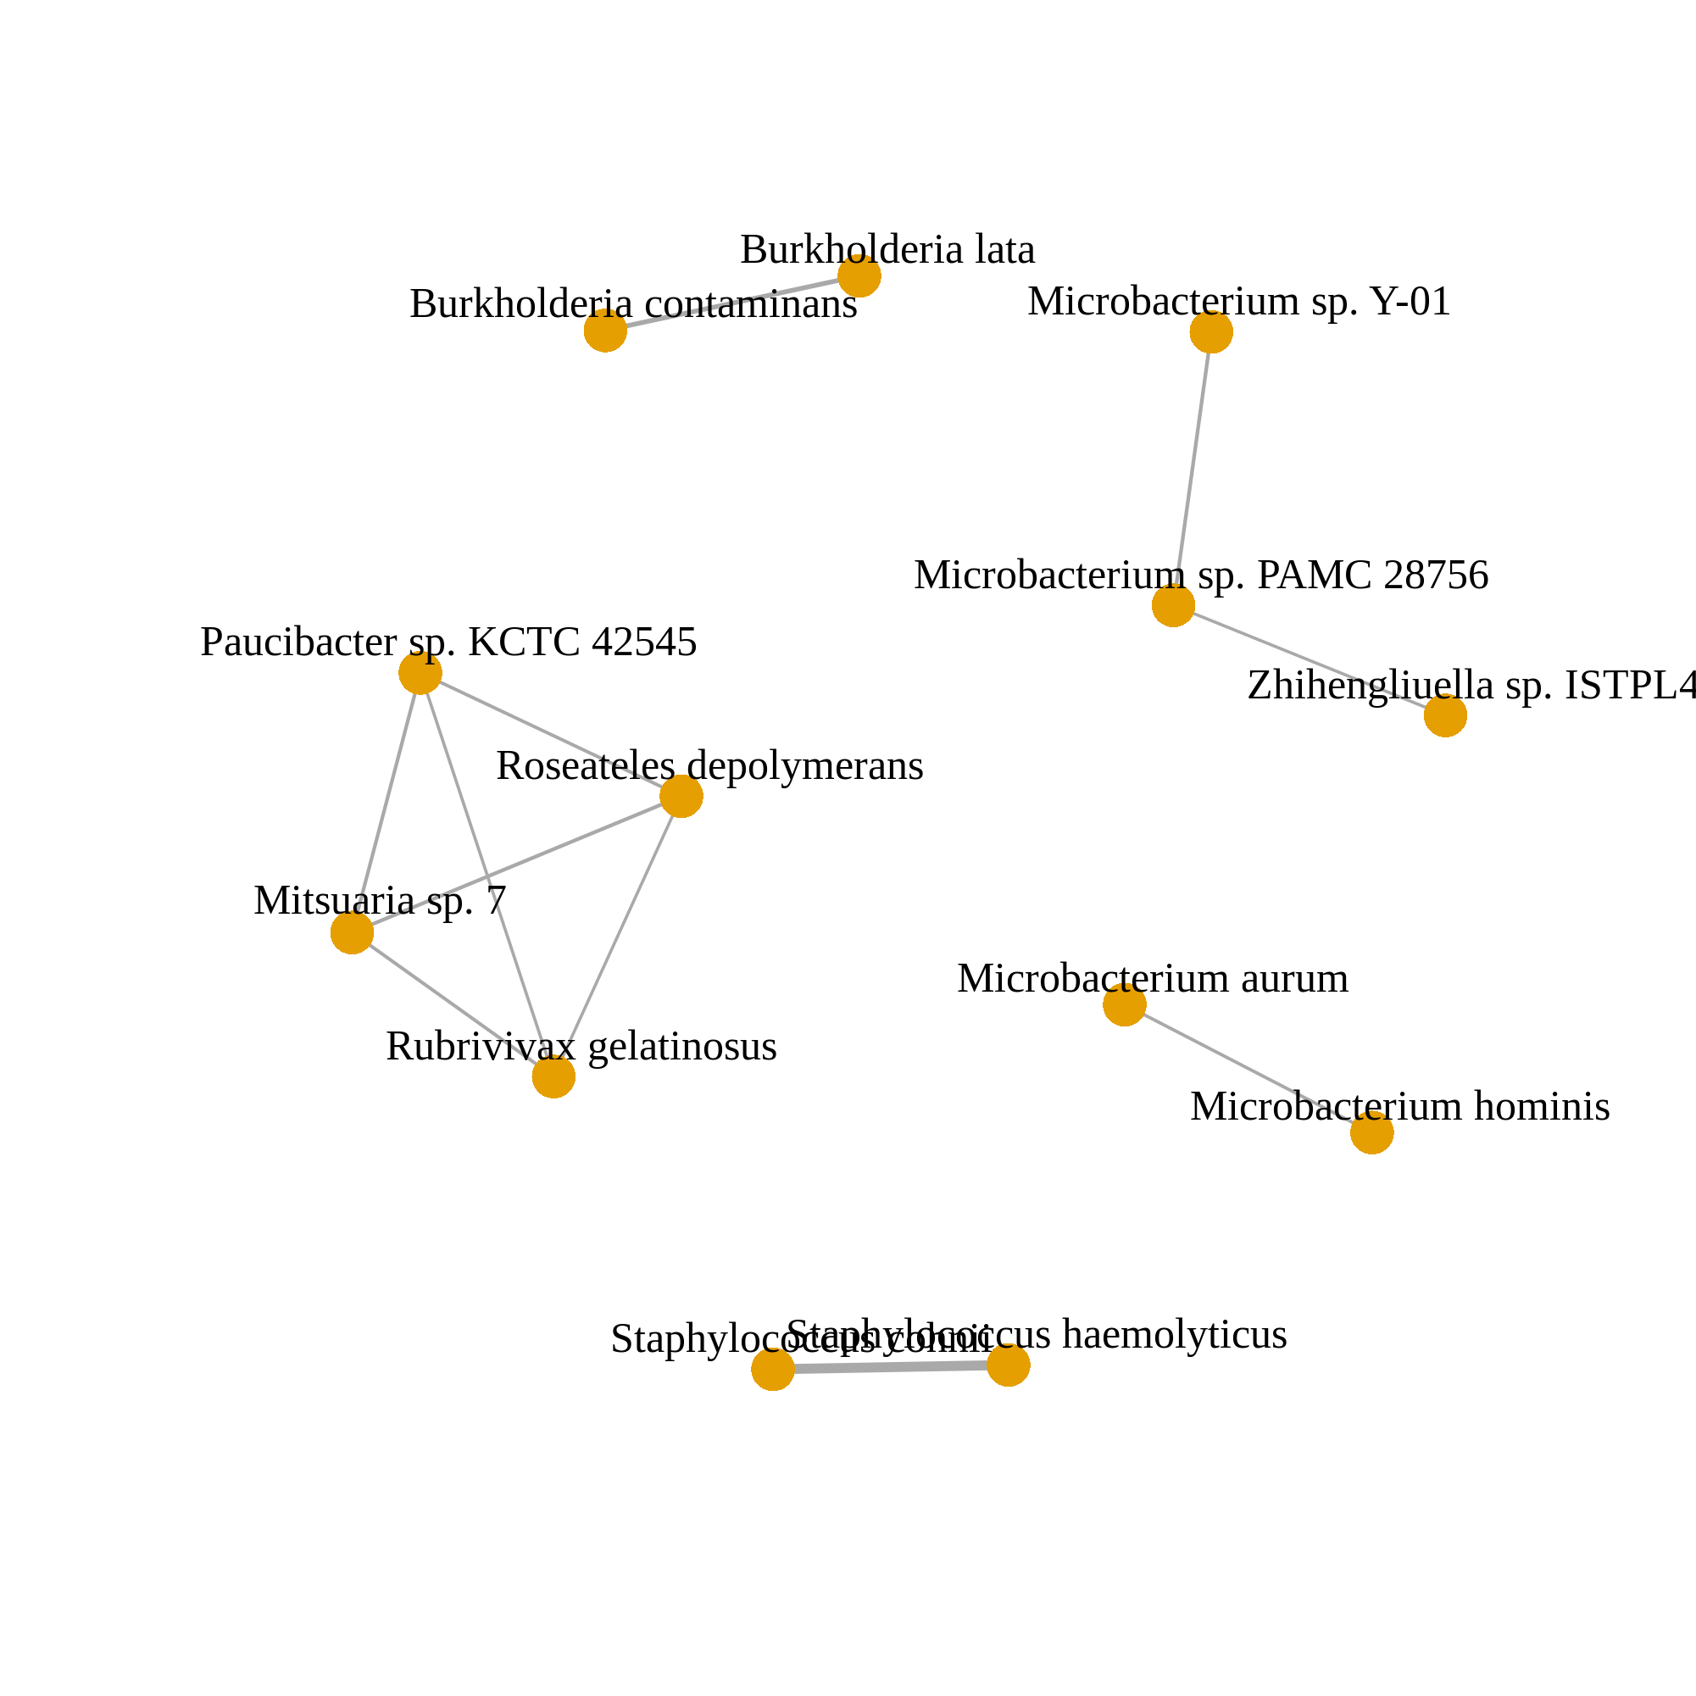
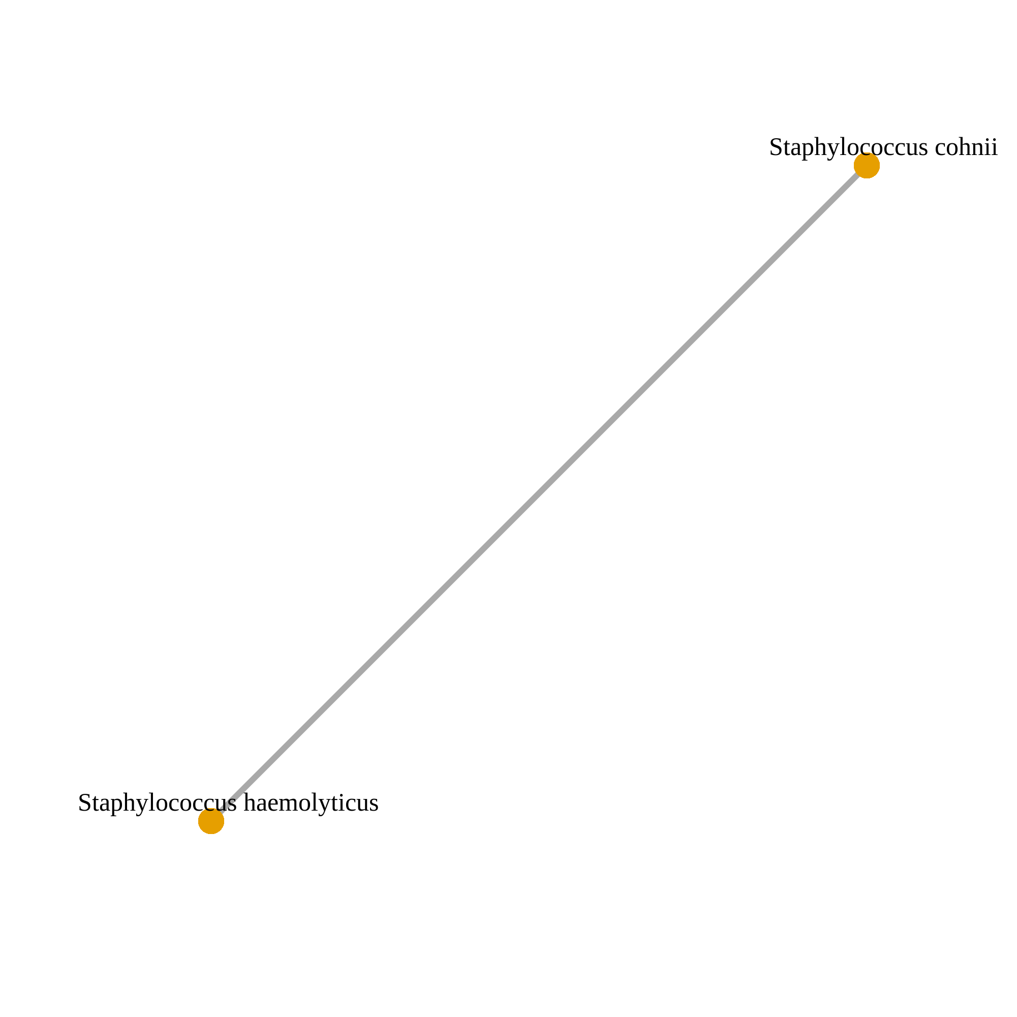
(a)
(b)
(c)
A. baumannii
A. xylosoxidans
(d)
Corr. > 0.05
Corr. > 0.1
Corr. > 0.2

Slide 7
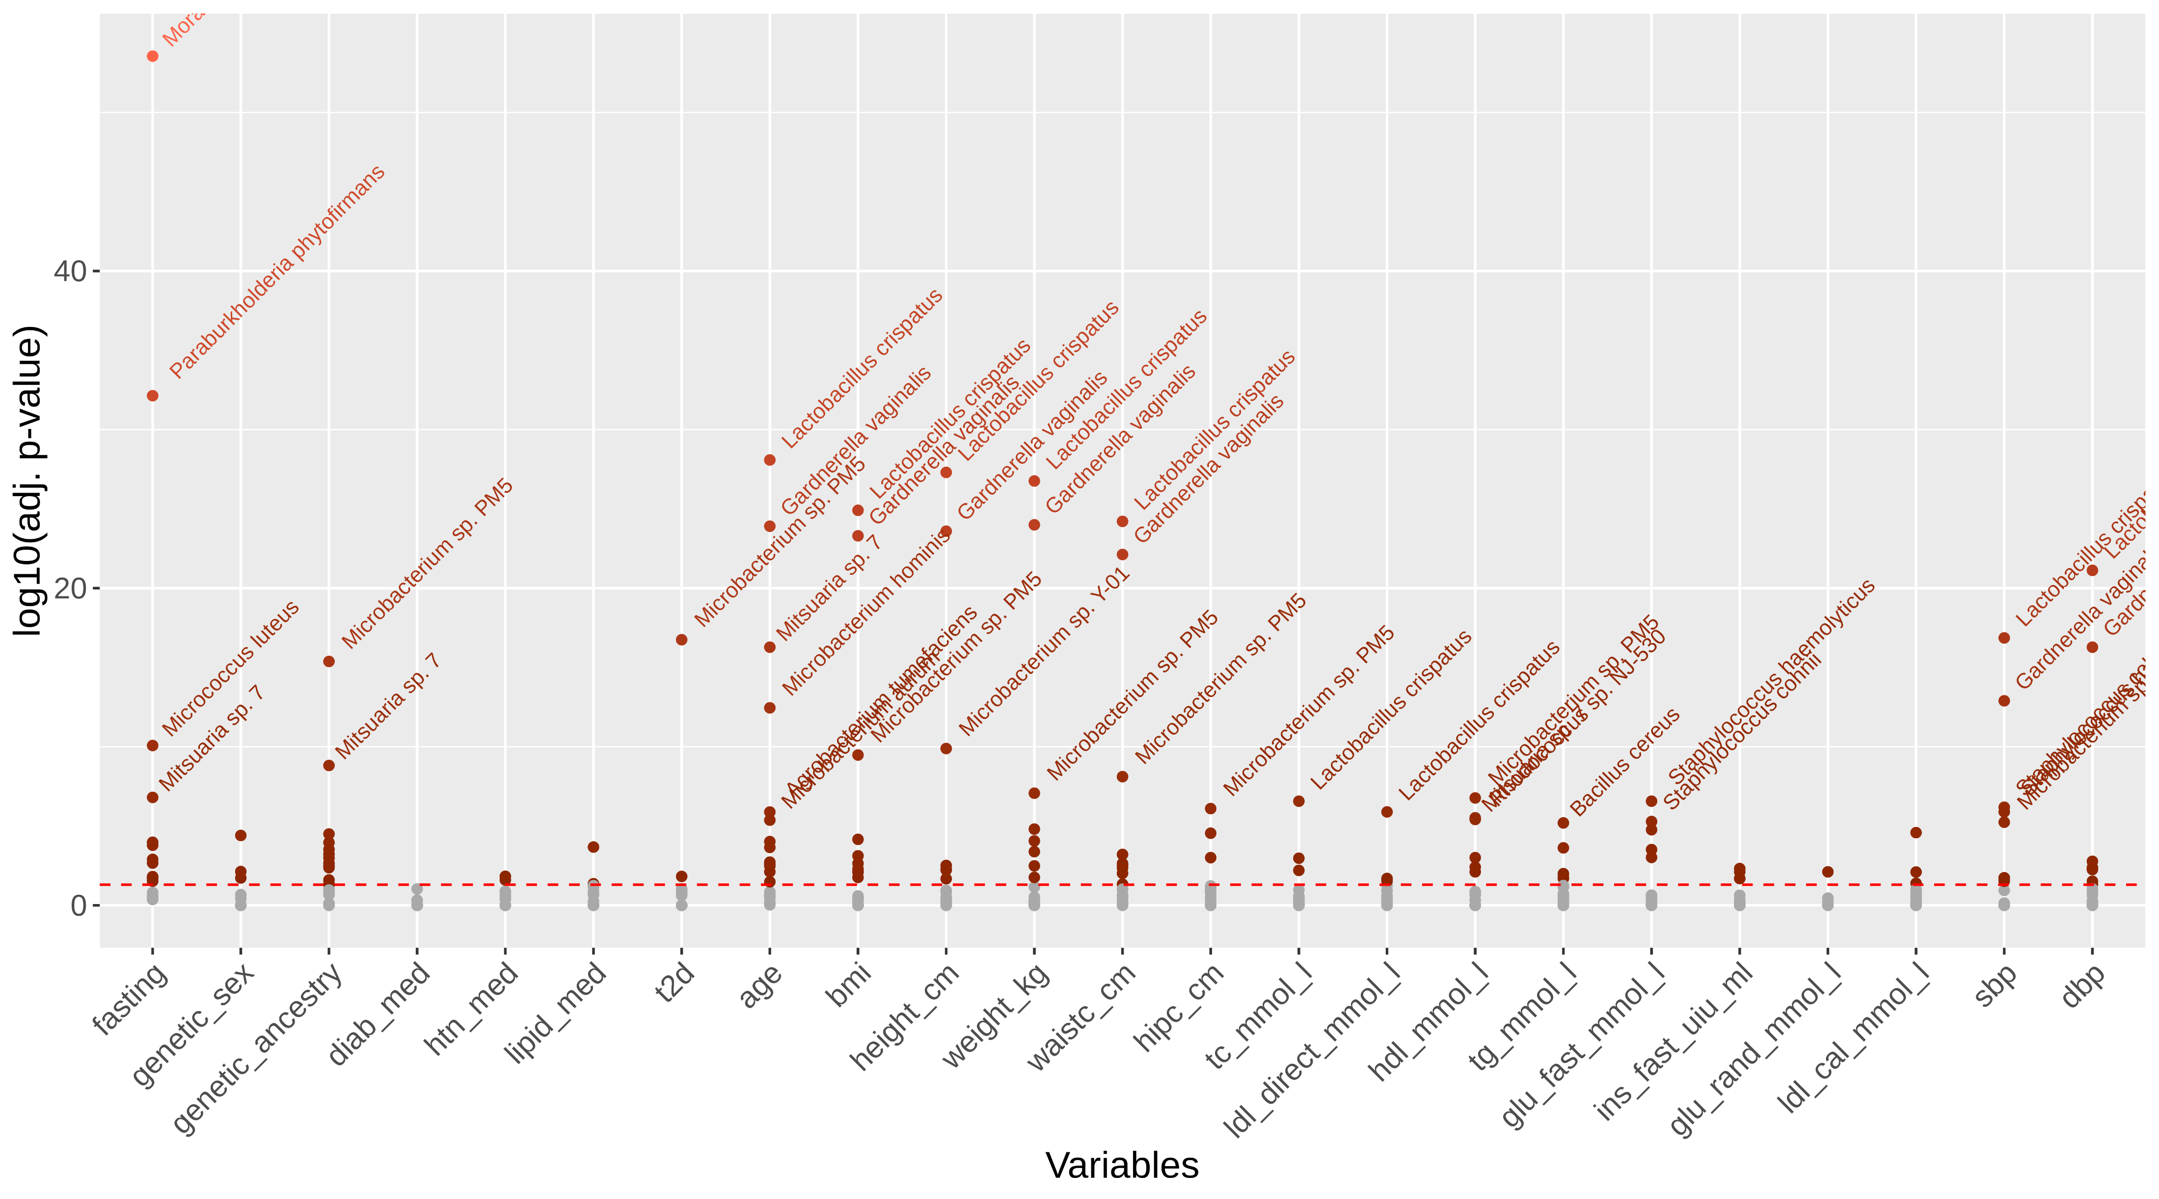
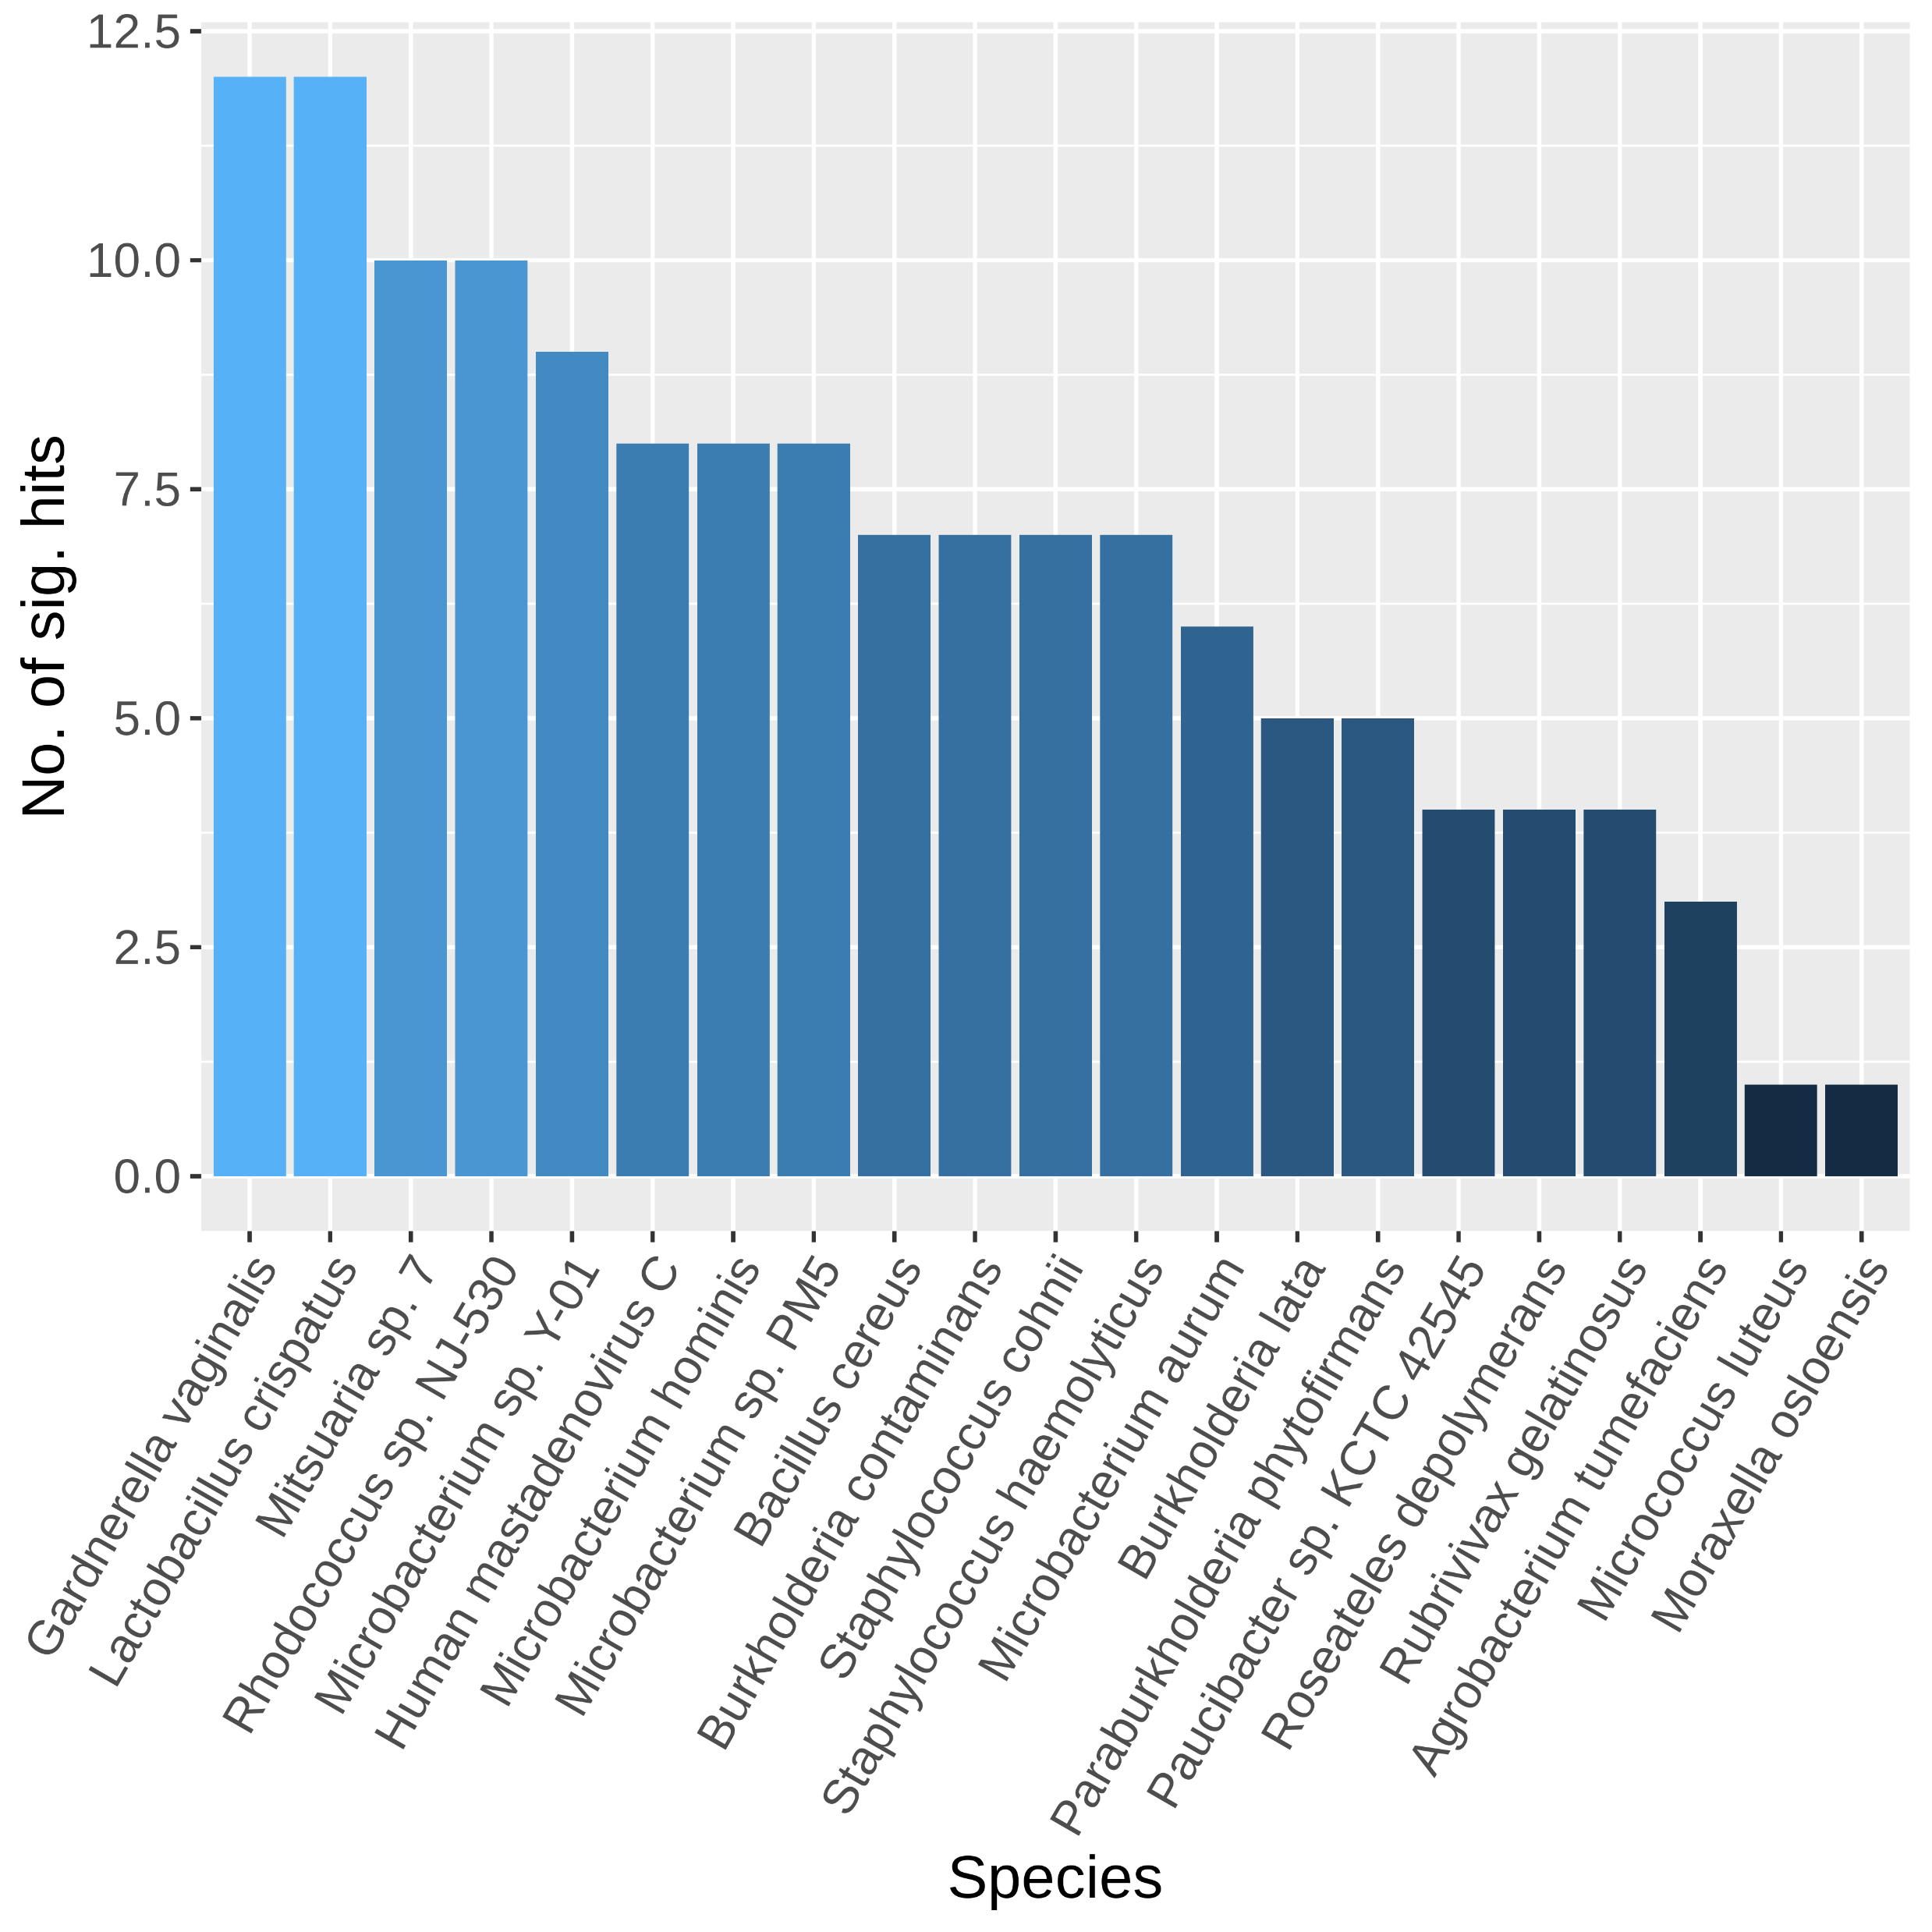
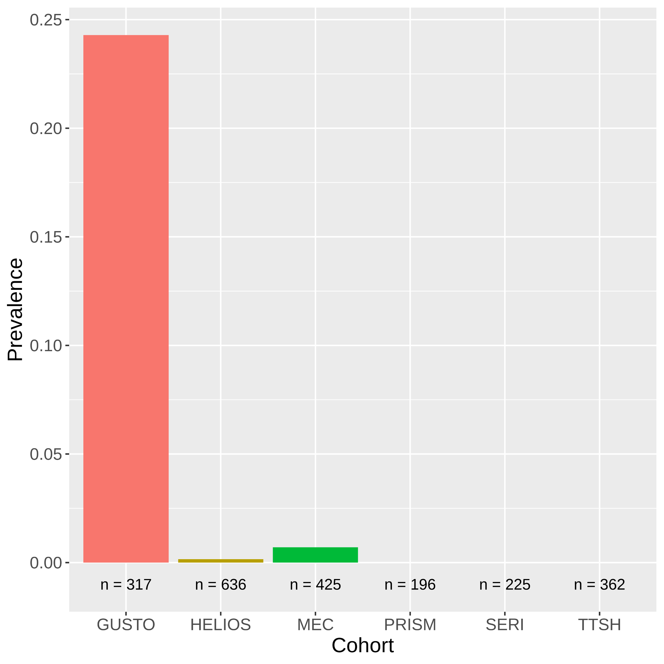
(a)
(b)
(c)
L. crispatus

